Slide 1

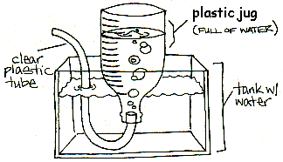
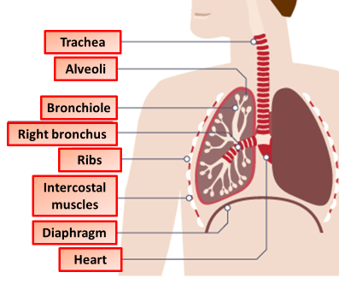
What is Your Lung Volume?
Introduction
Do you think you're fit and healthy? Let's test your lung volume to find out. Just how much air can your lungs can hold? With the help of a few simple household objects, some scientific know how and a dash of curiosity you can make this experiment look easy.
Instructions:
Make sure the plastic tubing is clean
Put about 10cm of water into your kitchen sink.
Fill the plastic bottle right to the top with water.
Put your hand over the top of the bottle to stop water escaping when you turn it upside down.
Turn the bottle upside down. Place the top of the bottle under the water in the sink before removing your hand.
Push one end of the plastic tube into the bottle.
Take a big breath in.
Breathe out as much air as you can through the tube.
Measure the volume of air your lungs had in them.
Make sure you clean up the area to finish.
What you'll need:
Clean plastic tubing
A large plastic bottle
Water
Kitchen sink or large water basin
What’s Happening
As you breathe out through the tube, the air from your lungs takes the place of the water in the bottle. If you made sure you took a big breath in and breathed out fully then the resulting volume of water you pushed out is equivalent to how much air your lungs can hold. Having a big air capacity in your lungs means you can distribute oxygen around your body at a faster rate. The air capacity of lungs (or VO2 max) increases naturally as children grow up but can also be increased with regular exercise.
Reflection Questions
Is something confusing me?
Could I explain this to someone else?

