Slide 1
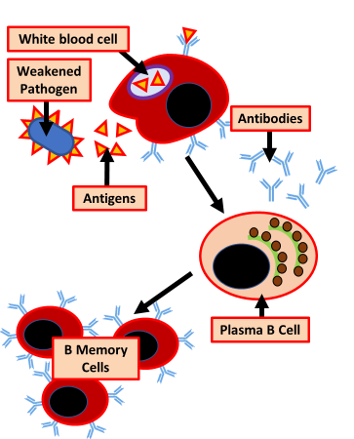
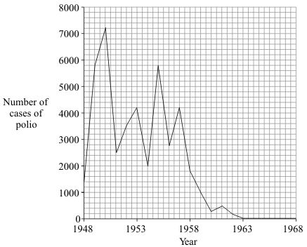
Vaccination
Specification Link:
Infection & Response
Highlight key words in the question below:
What are vaccines made from?
______________________________________________________________________________________
Vaccines allow a dead or altered form of the disease causing pathogen to be introduced into the body, which contain a specific antigen . This causes the immune system, specifically the white blood cells , to produce complementary antibodies , which target and attach to the antigen.
What do vaccines contain?
______________________________________________________________________________________
What do vaccines cause to be produced inside the body?
______________________________________________________________________________________
Vaccines containing these weakened or killed germs are introduced into your body, usually by injection. Your immune system reacts to the vaccine in a similar way that it would if it were being invaded by the disease — by making antibodies.
Using the diagram to the left, explain how vaccinations help prevent infection by pathogens in the future
__________________________________________________________________________________________________________________________________________________________________________________________________________________________________________________________________
In which year was the number of cases of polio highest?
______________________________________________
Polio vaccination was first used in the UK in 1955. How many years did it take for the number of cases of polio to fall to zero?
_______________________________________________________________________________________________________________
What is herd immunity?
_______________________________________________________________________________________________________________

