Slide 1
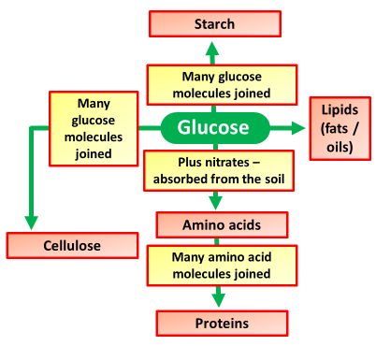
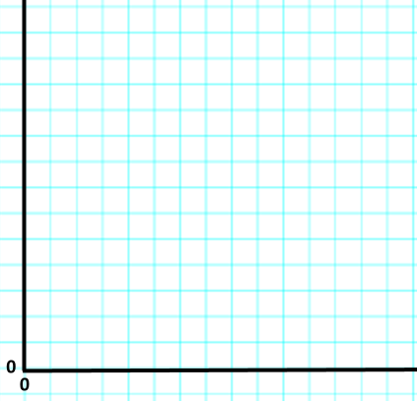
Key Words
Storage
Respiration
Growth
Y7 Bio 2
AO: Data presentation
Uses of Glucose
Before the lesson highlight key words or phrases in the information below
Use of Glucose SPAG Activity
The glicose made in photosynthesis is transpported around the plant as soluble sugar’s. Glucose is used in respiration to release energy for use by the plant's cells. However glucose is converted in insoluble substances’ for storage.
Plints use some of the glucose theyy produce for respiration.
Respiration ocurs in the mitochondria (in cells).
Glucose which is solubled is converted into insoluble starch for storage.
glucose is turned into lipids (fat’s & oils) four storing in seeds. Seeds Also store starch.
Glucose, along wi another sugar called fructose, is turned into sucroses for storing in fruits.
Glucose are converted into cellulose for makking cell walls, especialy in a rapidly growing plant.
Glucose is combined with nitrogenates (collected from the soil) to make ammino acids, which are them made intoo proteins.
The glucose made in photosynthesis is transported around the plant as soluble sugars. Glucose is used in respiration to release energy for use by the plant's cells. However, glucose is converted into insoluble substances for storage.
Task
Complete the averages in the table
Use the averages to complete a graph of the results
Photosynthesis rate | Plant growth (cm) |  |  | Average (cm)
 | 1 | 2 | 3
10 | 2 | 3 | 1
20 | 15 | 4 | 5
30 | 6 | 7 | 8
40 | 8 | 9 | 10

