Slide 1
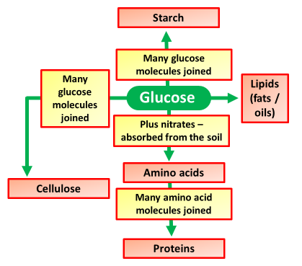
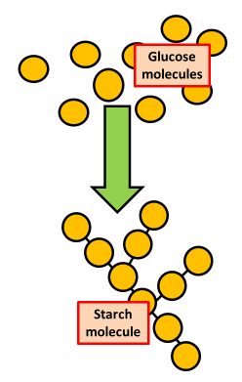
The Use of Glucose
Specification Link:
Bioenergetics
Highlight key words in the question below:
The glucose made in photosynthesis is transported around the plant as soluble sugars. Glucose is used in respiration to release energy for use by the plant's cells. However, glucose is converted into insoluble substances for storage.
Plants use some of the glucose they produce for respiration.
Respiration occurs in the mitochondria (in cells).
Glucose which is soluble is converted into insoluble starch for storage.
Glucose is turned into lipids (fats & oils) for storing in seeds. Seeds also store starch.
Glucose, along with another sugar called fructose, is turned into sucrose for storing in fruits.
Glucose is converted into cellulose for making cell walls, especially in a rapidly growing plant.
Glucose is combined with nitrates (collected from the soil) to make amino acids, which are them made into proteins.
What is the equation for photosynthesis?
Glucose molecules are combined together to make starch. Explain why glucose is stared as starch
_________________________________________________________________________________________________________________________________________________________________________________
Iodine solution is used to test leaves for the presence of starch. You need to:
heat a plant leaf in boiling water for 30 seconds (this stops its chemical reactions)
heat it in boiling ethanol for a few minutes (this removes most of its colour)
wash with water and spread onto a white tile
add iodine solution from a dropping pipette
After a few minutes, the parts of the leaf that contain starch turn blue-black.
Why does the leaf need boiling?
_________________________________________________________________________________________________________________________________
What results would you expect to see in a leaf during the day?
___________________________________________________________________________________________________________________________________________________________________________________________________________________________________________________________________
Why is the leaf put in ethanol?
_________________________________________________________________________________________________________________________________

