Slide 1


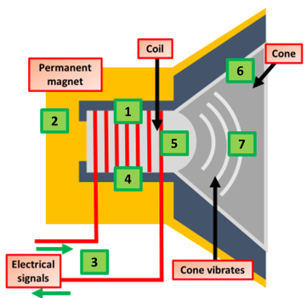
Use a Balloon to Amplify Sound
Introduction
Small sounds can still make a big noise when you use a good sound conductor. Experiment with a balloon, compressed air and your own ears to find out how it works and the science behind it.
What you'll need:
Balloon
What’s Happening
Instructions:
Blow up the balloon.
Hold the balloon close to your ear while you tap lightly on the other side.
Despite you only tapping lightly on the balloon your ears can hear the noise loudly. When you blew up the balloon you forced the air molecules inside the balloon closer to each other. Because the air molecules inside the balloon are closer together, they become a better conductor of sound waves than the ordinary air around you.
How Real Speakers Work
a current in the coil creates an electromagnetic field
the electromagnetic field interacts with the permanent magnet generating a force, which pushes the cone outwards
the current is made to flow in the opposite direction
the direction of the electromagnetic field reverses
the force on the cone now pulls it back in
repeatedly alternating the current direction makes the cone vibrate in and out
the cone vibrations cause pressure variations in the air, which are sound waves

