Slide 1
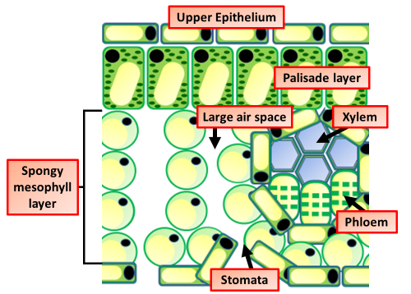
Leaf Structure
Y7 Bio 2
AO: Writing
Highlight key words in the information below:
Functions of a Leaf
Photosynthesis: This is the most important function of a leaf. They contain chloroplasts which have the pigment chlorophyll that is responsible for helping in photosynthesis. The prepared food is transported to the other parts of the plant via phloem tissue.
Helps the plant breathe: The epidermis of the leaf contains guard cells that control and regulate the small pores on the undersurface of the leaves. These pores are called stomata. Stomata are responsible for regulating water in and out of the cell. It is also responsible for the exchange of gases across the epidermis.
Storage of food: In some plants, the leaves are modified to store food. The glucose produced can be stored as starch
Waxy cuticle: See through layer which lets light through and stops the leaf from becoming water logged.
Where in the leaf does most photosynthesis take place?
_____________________________________________________________________________________________________________________
Palisade layer: Cells have lots of chloroplasts so can carry out lots of photosynthesis.
Spongy mesosphere layer: Rounded cells which, creates large air spaces within the leaf.
Guard cells: Open and close the air holes on the underside of the leaf so control the rate of transpiration.
What is the function of the large air spaces?
_____________________________________________________________________________________________________________________
Air spaces: Enable movement of carbon-dioxide into the leaf and oxygen out.
How does water reach the palisade cells?
____________________________________________________________________________________________________________________________________________________________
Phloem: Carries away glucose made in photosynthesis.
Xylem: Gives a good supply of water to the leaf so increases the rate of photosynthesis
The diagram below shows a section through a plant leaf. Describe the structure of the leaf and the functions of the tissues in the leaf. You should use the names of the tissues in your answer
._______________________________________________________________________________________________________________________________________________________________________________________________________________________________________________________________________________________________________________________________________________________________________________________________________________________________________________________________________________________________________________________________________________________________________________________________________________________________________________________________________________________

