Slide 1
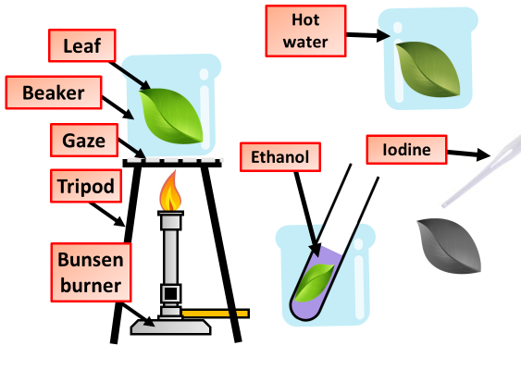
Testing leaves for starch
Y7 Bio 2
AO: Practical Skills
Experimental Command Words
Dependent Variable: The variable that responds to the independent variable. The dependent variable is the one being measured in the experiment
What is an error?
_____________________________________________________________________________________________________________________
Control Variable: Any variable that does not change during an experiment.
What is the difference between precision & accuracy?
_____________________________________________________________________________________________________________________
Hypothesis: A prediction of whether the independent variable will have an effect on the dependent variable or a prediction of the nature of the effect.
Independent Variable: The variable that is manipulated or changed by the researcher.
The diagram below shows the equipment used to test leaves for starch
Anomaly: An anomaly is an observation that differs from expectation or from accepted scientific views.
Error: Error is a measure of the difference between a measured or calculated value and a true value.
Precision and accuracy are often used interchangeably, but in science they have very different meanings. Measurements that are close to the known value are said to be accurate, whereas measurements that are close to each other are said to be precise.
Why is the leaf boiled?
______________________________________________________________________________
Outline an experiment you can carry out to test leaves for starch
_________________________________________________________________________________________________________________________________________________________________________________________________________________________________________________________________________________________________________________________________________________________________________________________________________________________________________________________________________________________________________________________________________________________________________________________________________
Why should the flame be turned off before heating the ethanol?
______________________________________________________________________________
Why does chlorophyll need to be extracted before testing for starch?
______________________________________________________________________________
What colour does iodine turn if starch is present?
______________________________________________________________________________

