Slide 1

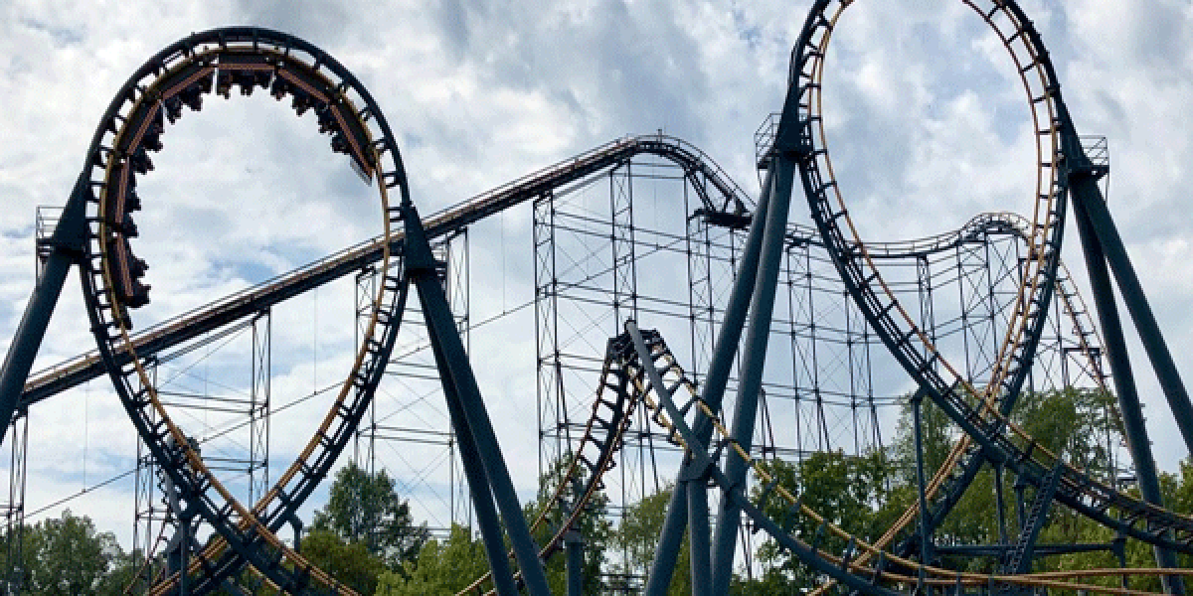
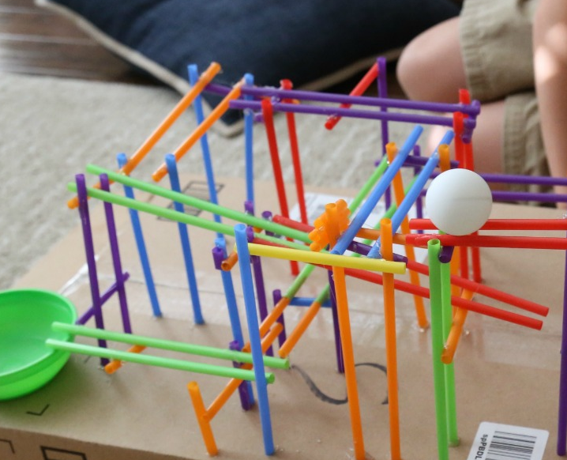
STEM: Straw Roller Coaster
Introduction
Roller Coaster Challenge is a mind-bending three-dimensional playground for engineers. Your goal is to create a functioning roller coaster that can get the car to safely glide to the end of the track.
Your Challenge!
Build a Straw Roller Coaster for a ping pong ball to roll down! Drinking straws and hot glue, and that’s it. Use a low temp gun and kids can make this themselves.
What you'll need:
To build this straw roller coaster you will need:
A cardboard box or a piece of cardboard for the base
Straws – solid color ones are fun!
Scissors
A hot glue gun and glue sticks
A ping pong ball
A bowl to catch the ball at the bottom (optional)
Things to think about
How high are you going to start your roller coaster?
How are you going to make sure that your ball doesn’t move that fast it falls off?
How are you going to make your ball go round corners?
Is it better to have your ball moving fast or slow?
How are you going to connect your straws together
Reflection Questions
What should I do first?
Is something confusing me?
Where can I look for help?
How can I do it better?

