Slide 1

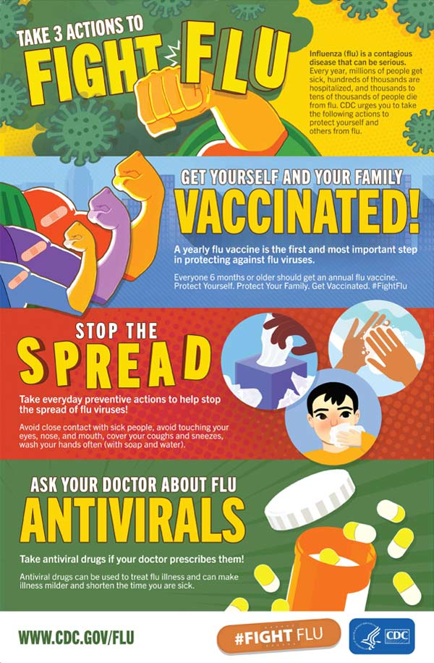
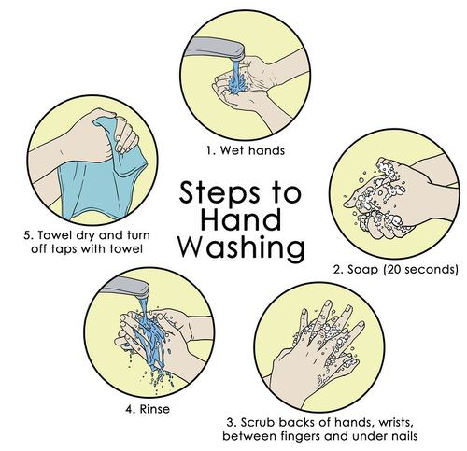
STEM: Stop the Spread
Introduction
Infectious diseases can be spread through direct contact such as: Person to person. Infectious diseases commonly spread through the direct transfer of bacteria, viruses or other germs from one person to another.
Your Challenge!
Imagine you work for a charity and have received some funding to help pupils in a school in Kenya reduce the spread of disease in their school. Your challenge is to:
Build a model of a hand washing device that could go in their playground which will enable them to capture rainwater then use it to wash their hands.
Develop education materials which will help children aged 8-11 understand why hand washing is important. This could be a poster, animation, game, play, leaflet.
Things to think about
You will need to think about:
For your hand washing device
Remember it must be able to both collect and dispense water.
It must use water efficiently (water is scarce in Kenya).
Think about how to avoid cross-contamination.
Use locally available, sustainable materials when possible.
Reflection Questions
Is something confusing me?
Could I explain this to someone else?

