Slide 1

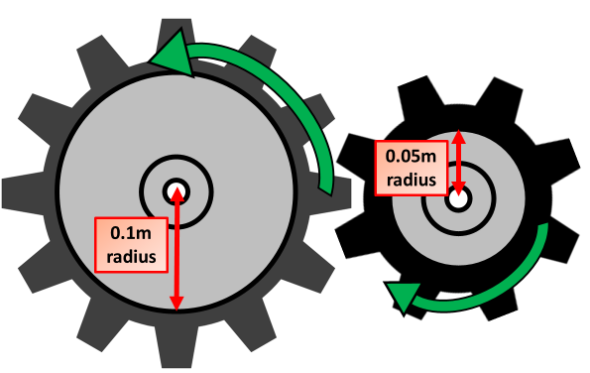
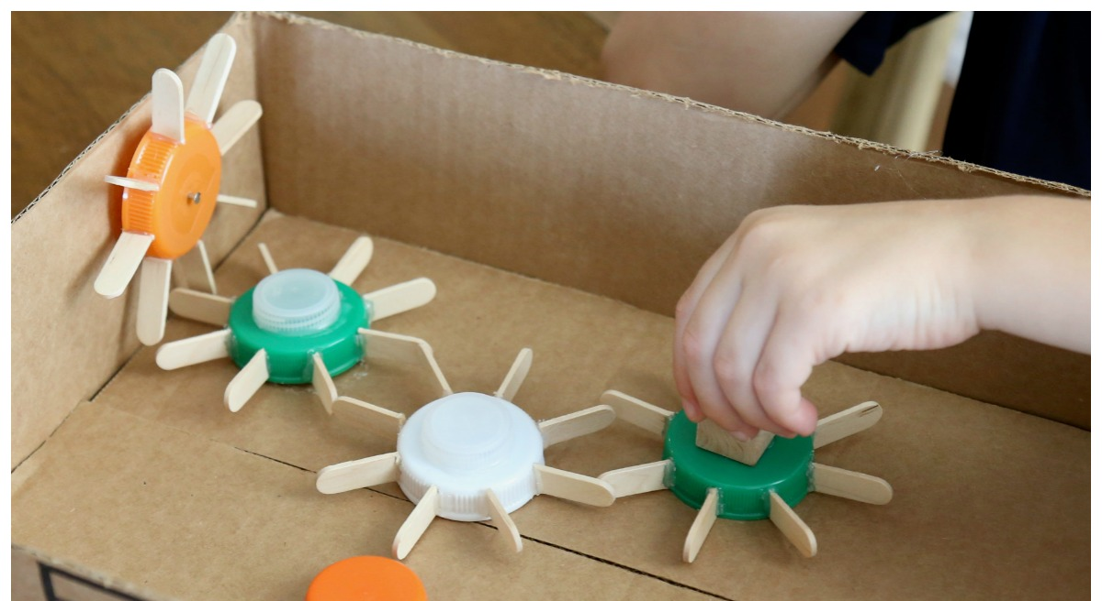
STEM: Stick Gears
Introduction
Gears are wheels with toothed edges that rotate on an axle or shaft. The teeth of one gear fit into the teeth of another gear. This lets one gear turn the other, meaning one axle or shaft can be used to turn another shaft..
Your Challenge!
Build a series of gears out of lollipop sticks, bottle tops and cardboard. You need to start at one side of a cardboard box with your first gear and make your final gear change at the opposite end of the box
Things to think about
Reflection Questions
How are you going to attach the lollipop sticks to the bottle tops?
How are you going to make them spin?
How many cogs are you going to have on each gear and how will this effect how quickly the gear turns?
What should I do first?
Is something confusing me?
Could I explain this to someone else?
What you'll need:
Lollipop sticks
Glue
A carboard box
Scissors
Cocktail sticks , nails or screws
Where can I look for help?
How can I do it better?

