Slide 1

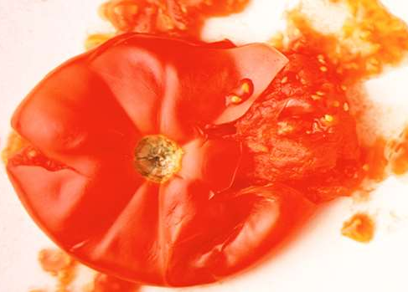
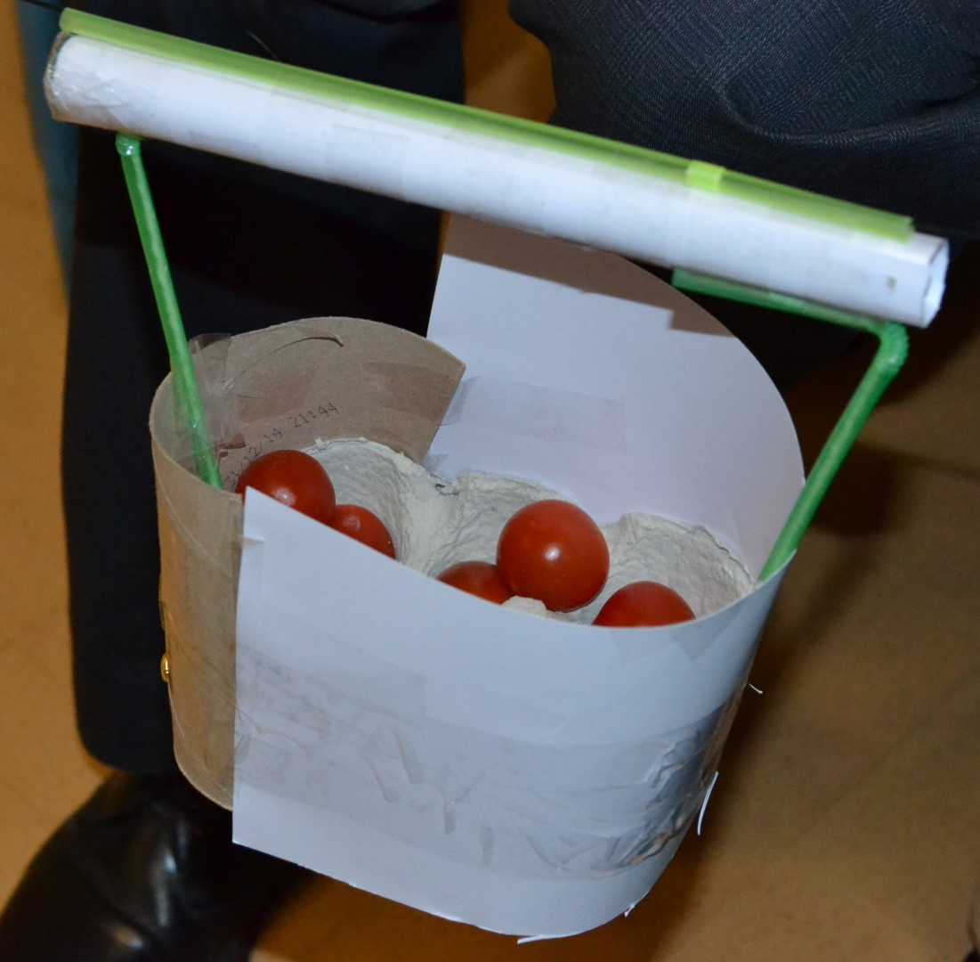
STEM: Squashed Tomato Challenge
Introduction
In Nepal many farmers living on the mountainside grow fruit and vegetables, including tomatoes. To earn a living they need to sell these at the local market. The problem is getting to market involves a long, dangerous walk down the mountain side and over a river, at the end of which the tomatoes may well be a bit squashed..
Your Challenge!
Imagine you are a group of engineers working together on Global Goal 11. You need to find a way to help farmers in Nepal transport their tomatoes down the mountain to market.
The tomatoes must be transported a minimum of one metre, not touching the ground.
The tomatoes cannot be touched whilst they are moving, catapulted or ‘flown’ in any way! They must be moved in a controlled way.
Things to think about
Reflection Questions
You will need to think about:
whether you want your model to float and if so, how you can make it do so.
how to make the top of your model suitable to grow crops on. Does it need to be flat? Layered?
the size of your model. It needs to be tested by placing it on water in a washing up bowl or sink.
What should I do first?
Is something confusing me?
Could I explain this to someone else?
Where can I look for help?
How can I do it better?

