Slide 1
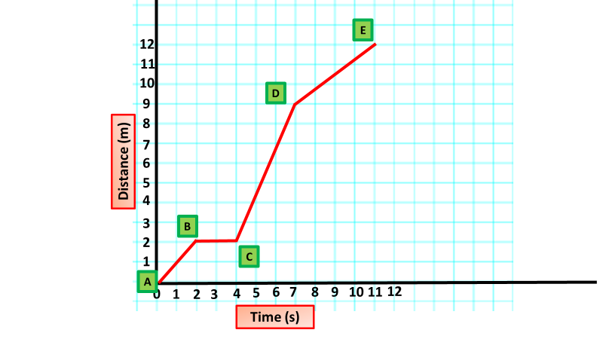
Graphically representing speed, Analysis & evaluation
Speed Graph Analysis
Y7 Science Introduction
Introduction: Use the graph below and your own knowledge about speed to fill out the table
Distance A-B |  | Time A-B
Distance B-C |  | Time B-C
Distance C-D |  | Time C-D
Distance D-E |  | Time D-E
Distance A-E |  | Time A-E
Speed = Distance / Time
Speed
Speed Graph Analysis
Y7 Science Introduction
Introduction: Use the graph below and your own knowledge about speed to fill out the table
Distance A-B |  | Time A-B
Distance B-C |  | Time B-C
Distance C-D |  | Time C-D
Distance D-E |  | Time D-E
Distance A-E |  | Time A-E
Speed = Distance / Time
Speed

