Slide 1

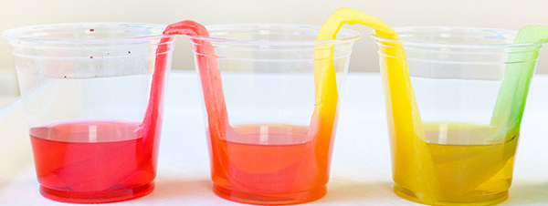
Escaping Water
Introduction
Water can certainly move in mysterious ways, get the water from one cup to make its way up hill and back down into a second empty cup with the help of paper towels and an interesting scientific process.
What’s Happening
What you'll need:
A glass of water
An empty glass
Some paper towels
Your paper towel rope (or wick) starts getting wet, after a few minutes you will notice that the empty glass is starting to fill with water, it keeps filling until there is an even amount of water in each glass, how does this happen?
This process is called 'capillary action', the water uses this process to move along the tiny gaps in the fibre of the paper towels. It occurs due to the adhesive force between the water and the paper towel being stronger than the cohesive forces inside the water itself. This process can also be seen in plants where moisture travels from the roots to the rest of the plant.
Capillary action happens when 3 forces called cohesion, adhesion, and surface tension work together, so let's look at these forces and how they cooperate to cause capillary action.
Instructions:
Twist a couple of pieces of paper towel together until it forms something that looks a little like a piece of rope, this will be the 'wick' that will absorb and transfer the water (a bit like the wick on a candle transferring the wax to the flame).
Place one end of the paper towels into the glass filled with water and the other into the empty glass.
Watch what happens (this experiment takes a little bit of patience).
Reflection Questions
Is something confusing me?
Could I explain this to someone else?

