Slide 1
Respiration Data Analysis
Y8 Bio 2
AO: Data presentation
Mins of exercise | Pulse rate per min |  |  | Average pulse rate
 | 1 | 2 | 3
1 | 70 | 73 | 71
2 | 84 | 90 | 88
3 | 101 | 99 | 105
4 | 130 | 135 | 133
5 | 140 | 150 | 160
The mean is the average of the numbers. It is easy to calculate: add up all the numbers, then divide by how many numbers there are. In other words it is the sum divided by the count.
Task
Complete the table below by calculating the mean for each length of exercise.
Produce a graph of the results in your table
Explain the pattern in your results

Slide 2
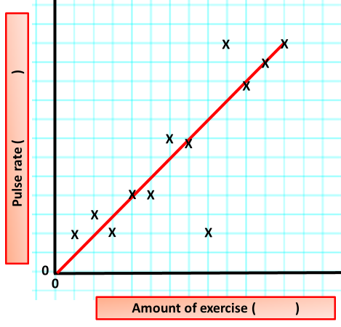
Respiration Data Analysis
Y8 Bio 2
AO: Data presentation
How to get marks when drawing graphs:
Labelled axis
Units on axis
Correct scale used on axis
Points using means plotted correctly
An appropriate line of best fit
Any anomalous results circled
Task
Produce a graph of the results in your table
Explain the pattern in your results

