Slide 1

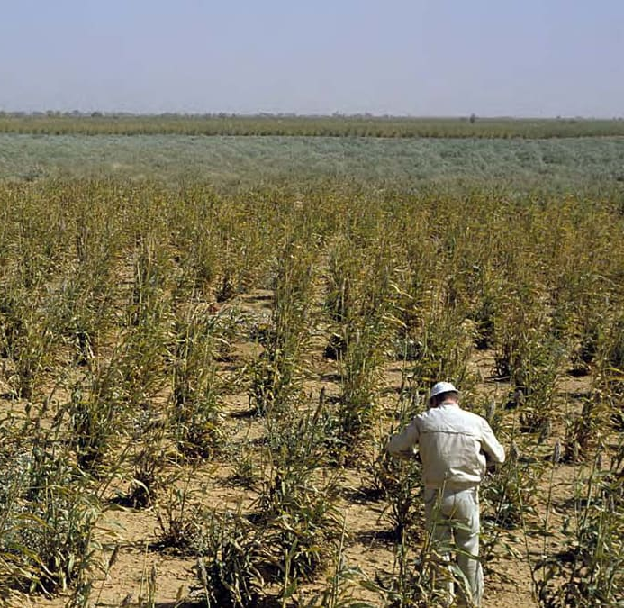
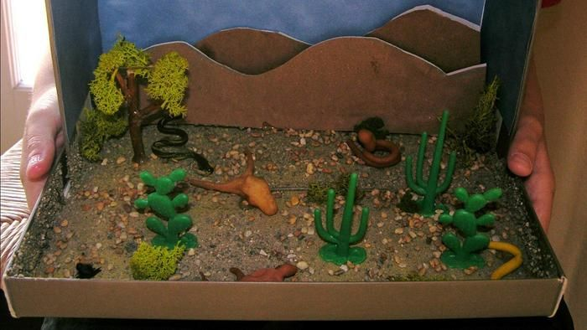
STEM: Re-green the Desert
Introduction
Desert greening is the process of man-made reclamation of deserts for ecological reasons (biodiversity), farming and forestry, but also for reclamation of natural water systems and other ecological systems that support life..
Your Challenge!
Can you come up with an ingenious solution to help families in Sudan overcome climate change and turn the desert green?
Things to think about
Reflection Questions
You will need to think about:
Your model must be able to collect and store rain water.
Water is precious so you need to be able to turn the flow of water on and off.
We want your model to be able to water at least 6 plants at the same time.
At least one of the plants your model waters should be 30cm or more away from where the water is stored.
What should I do first?
Is something confusing me?
Could I explain this to someone else?
Where can I look for help?
How can I do it better?
Have I describe the functions of the different parts?
Do I know why doing this might be important?

