Slide 1
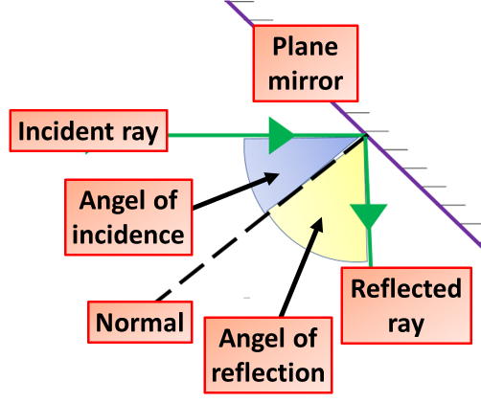
Reflection, Analysis & evaluation
Reflection Analysis
Y7 Science Introduction
Introduction: Use the information in the table below and your own knowledge to work through the 3 task questions
Angle of incidence | Angle of reflection
20° | 20°
30° | 19°
40° | 40°
50° | 50°
Task
What is the pattern in the results
Which result is anomalous?
Using these results, what is the law of reflection?
Reflection Analysis
Y7 Science Introduction
Introduction: Use the information in the table below and your own knowledge to work through the 3 task questions
Angle of incidence | Angle of reflection
20° | 20°
30° | 19°
40° | 40°
50° | 50°
Task
What is the pattern in the results
Which result is anomalous?
Using these results, what is the law of reflection?

