Slide 1
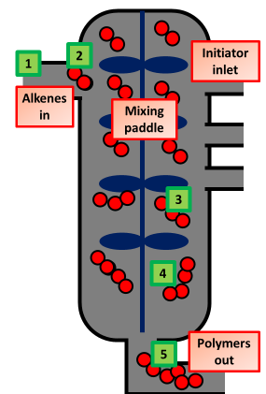
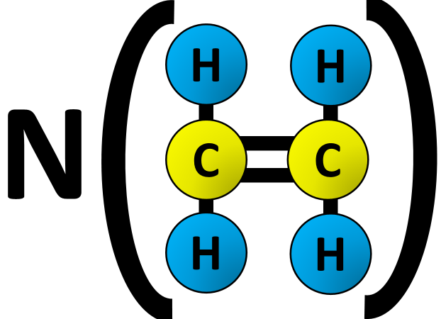
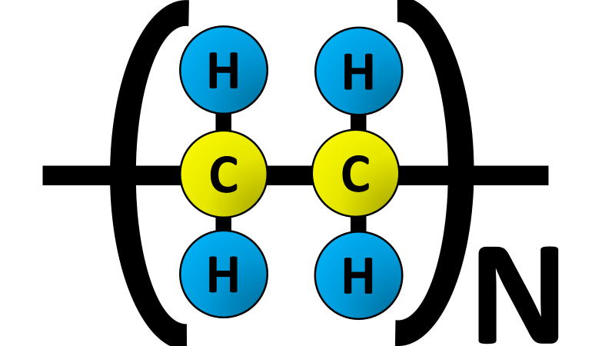
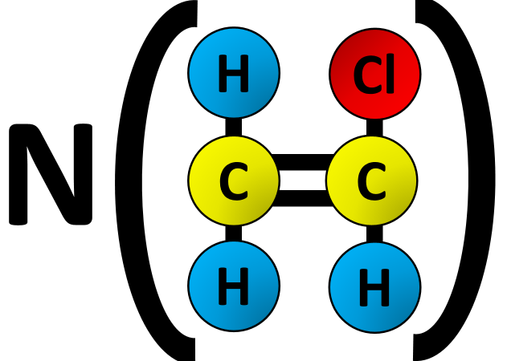
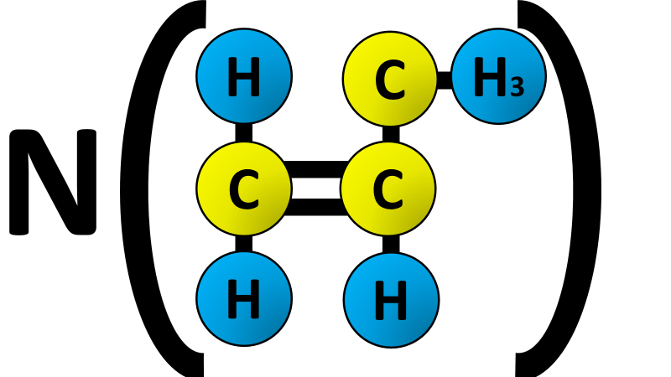
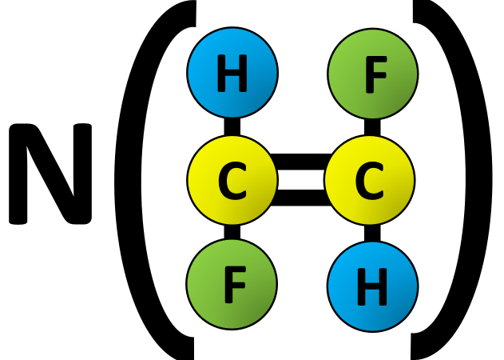
Polymerisation Question
Specification Link:
Organic Chemistry
Highlight key words or phrases
Polymerisation is the chemical process of monomers joining together to form polymers, often it takes many thousands of monomers to make a single polymer.
The diagram shows how polymers are produced. Describe this process in 6 stages:
_________________________________________________________________________________________________________________________________________________________________________________________________________________________________________________________________________________________________________________________________________________________________________________________________________________________________________________________
Highlight key words or phrases
Addition polymerisation involves addition reactions in which a large number of small molecules (monomers) join together to form very large molecules (polymers). Alkenes are particularly useful monomers as they contain double bonds and can be made to undergo addition reactions amongst themselves
Monomer
Polymer
The diagram above shows how a polymer is shown. Complete the examples below:
Explain what is meant by the term polymerisation.
________________________________________________________________________________________________________________________________________________________________________________________________________________________________________________________________________________________________________________________
In the table you have completed explain why is this an addition polymerisation?
__________________________________________________________________________________________________________________

