Slide 1

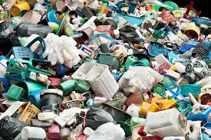
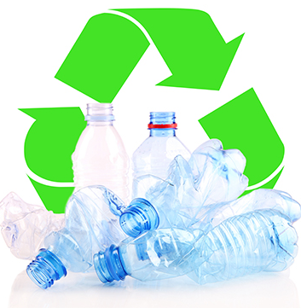
STEM: Plastic Challenge
Introduction
Plastic sticks around in the environment for ages, threatening wildlife and spreading toxins. Plastic also contributes to global warming. Almost all plastics are made from chemicals that come from the production of planet-warming fuels (gas, oil and even coal).
Your Challenge!
The charity Practical Action would like you to raise funds for the work that they do around the world by designing a product you can sell as a fund-raiser.
They would like the product:
to have a strong sustainability message so would like you to use plastic ‘waste’ that is easily available
should be cheap to make but safe to use and have a high quality finish.
Things to think about
Reflection Questions
What are plastics?
Why should we recycle plastic?
How can we recycle plastic?
What are the problems with not recycling plastic?
Why should people care?
What should I do first?
Is something confusing me?
Could I explain this to someone else?
Where can I look for help?
How can I do it better?

