Slide 1
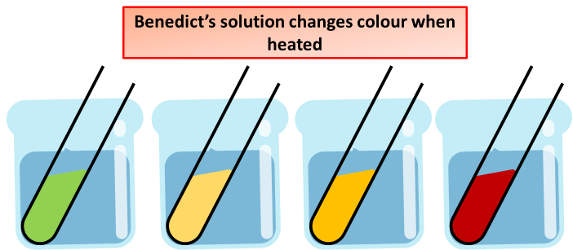
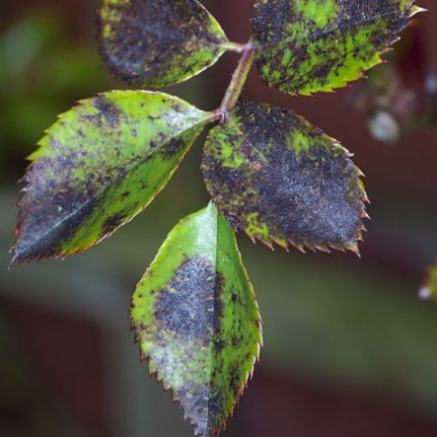
Plant Disease
Specification Link:
Infection & Response
Highlight key words in the question below:
What are pathogens?
______________________________________________________________________________________
The tobacco mosaic virus infects tobacco and lots of other closely related species like tomatoes and peppers. It is transmitted by contact between plants, either naturally or on the hands of farmers. It infects the chloroplasts of plant leaves and changes their colour from green to yellow or white in a mosaic pattern. It can also make leaves crinkled or curled up. This reduces the plant's ability to photosynthesise and grow properly, which can reduce farmers' crop yields.
What does tobacco mosaic virus infect?
______________________________________________________________________________________
How can pathogens be transmitted between plants?
______________________________________________________________________________________
Describe the effects of reducing photosynthesis in plants
__________________________________________________________________________________________________________________________________________________________________________
Sugars classed as reducing sugars will react with Benedict's solution on heating for a few minutes. Glucose is an example of a reducing sugar.
Reducing sugars give a red-brown precipitate with Benedict's solution. The precipitate takes a while to settle in the tube – you're more likely to see simply a red or brown colour. If there's not much glucose present, the final colour may be green or yellow, or orange if there's a little more.
Rose black spot is caused by a fungus which infects roses. It infects leaves and causes black or purple spots on the leaves. The rest of the leaves often turn yellow and can drop off the plant. This reduces the plant's ability to photosynthesise and reduces growth. Black rose spot can be transmitted in air or water as well as direct contact by gardeners. It is treatable using fungicides and by removing and destroying infected leaves.
Some plants produce fruits which contain glucose.
Describe how you would test for the presence of glucose in fruit.
__________________________________________________________________________________________________________________________________________________________________________________________________________________________________________________________________
What causes Rose black spot?
____________________________________________________________________________________________________________________
What effect does Rose black spot have on plants?
______________________________________________________________________________________________________________________________________________________________________________

