Slide 1
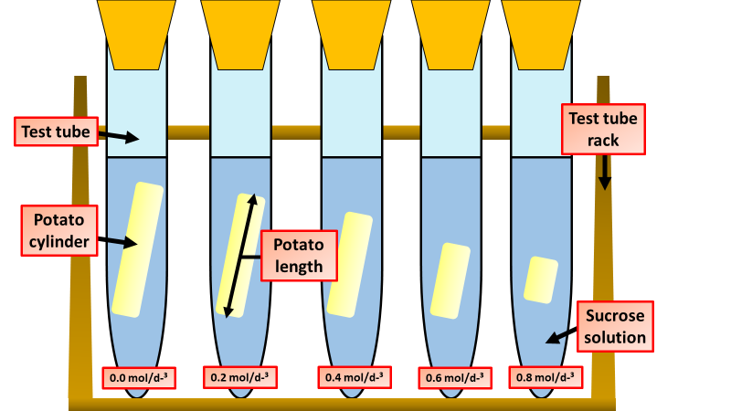
Osmosis Investigation
Specification Link:
Organisation
Independent variable – the variable that is altered during a scientific experiment.
Dependent variable – the variable being tested or measured during a scientific experiment.
Controlled variable – a variable that is kept the same during a scientific experiment. Any change in a controlled variable would invalidate the results.
The diagram shows the apparatus a student used to investigate osmosis in potatoes
What is the independent variable?
____________________________________
What is the dependent variable?
____________________________________
Osmosis
Osmosis is the movement of water molecules, across a partially permeable membrane, from a region of high concentration of water to a low concentration of water molecules. It allows plants to take in water through their roots.
What do the results above show?
____________________________________________________________________________________________________________________________________
How could the results above be made more accurate?
________________________________________________________________________________________
The table below shows the results:
Sugar solution in mol dm⁻³ | Starting mass in g | Final mass in g | Change of mass in g | (%) change
0.0 | 1.30 | 1.51 | 0.21 | 16.2
0.2 | 1.35 | 1.50 | 0.15 | X
0.4 | 1.30 | 1.35 | 0.05 | 3.8
0.6 | 1.34 | 1.28 | −0.06 | −4.5
0.8 | 1.22 | 1.11 | −0.11 | −9.0
Calculate the value of X
______________________________________________________________
Why did the student calculate the percentage change in mass as well as the change in grams?
_____________________________________________________________________________________________
Explain why the percentage change results are positive and negative.
____________________________________________________________________________________________________________________________
Suggest two possible sources of error?
___________________________________________________________________________________________________________________________________________________

