Slide 1
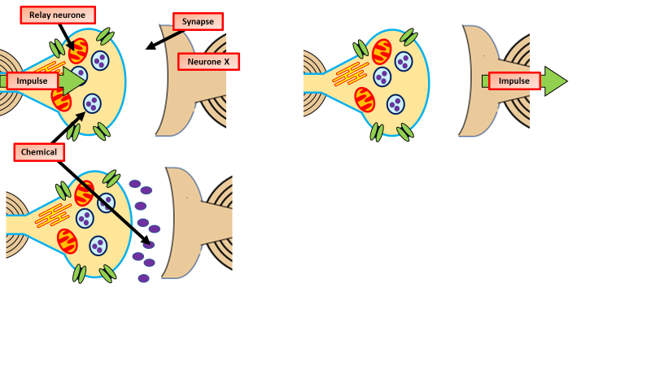
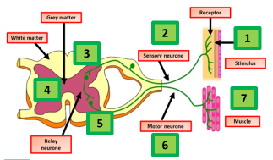
Nerves & reflexes
Specification Link:
Highlight key words in the information below:
What are some of the adaptations of nerve cells that makes them good for carrying nerve impulses?
___________________________________________________________________________________________________________________________________________________________________________________________________________________________________________________________________
Neurones are nerve cells that carry information as tiny electrical signals. There are three different types of neurones, each with a slightly different function:
sensory neurones carry signals from receptors to the spinal cord and brain
relay neurones carry messages from one part of the CNS to another
motor neurones carry signals from the CNS to effectors.
Synapses
An electrical impulse travels along an axon.
This triggers the nerve-ending of a neuron to release chemical messengers called neurotransmitters.
These chemicals diffuse across the synapse (the gap) and bind with receptor molecules on the membrane of the next neuron.
The receptor molecules on the second neuron bind only to the specific chemicals released from the first neuron. This stimulates the second neuron to transmit the electrical impulse
Explain how impulses travel over a synapse
__________________________________________________________________________________________________________________________________________________________________________________________________________________________________________________________________________________________________
Explain what happens during a reflex
___________________________________________________________________________________________________________________________________________________________________________________________________________________________________________________________________________________________________________________________________________________________________________________________________________________________________________________________________________________________________________________________________________________________________________________________________________________________________________________________________________________________________
A reflex, or reflex action, is an involuntary and nearly instantaneous movement in response to a stimulus. A reflex is made possible by neural pathways called reflex arcs which can act on an impulse before that impulse reaches the brain.

