Slide 1

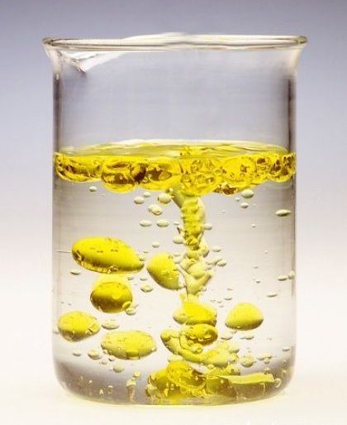
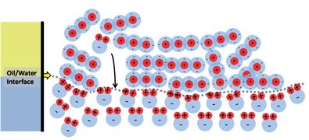
Mixing Oil and Water
Introduction
Some things just don't get along well with each other. Take oil and water as an example, you can mix them together and shake as hard as you like but they'll never become friends.....or will they? Take this fun experiment a step further and find out how bringing oil and water together can help you do your dishes.
What you'll need:
Small soft drink bottle
Water
Food colouring
2 tablespoons of cooking oil
Dish washing liquid or detergent
What’s Happening
While water often mixes with other liquids to form solutions, oil and water does not. Water molecules are strongly attracted to each other, this is the same for oil, because they are more attracted to their own molecules they just don't mix together. They separate and the oil floats above the water because it has a lower density.
Instructions:
Add a few drops of food colouring to the water.
Pour about 2 tablespoons of the coloured water along with the 2 tablespoons of cooking oil into the small soft drink bottle.
Screw the lid on tight and shake the bottle as hard as you can.
Put the bottle back down and have a look, it may have seemed as though the liquids were mixing together but the oil will float back to the top.
Reflection Questions
The water molecules attract each other, and the oil molecules stick together. That causes oil and water to form two separate layers. Water molecules pack closer together, so they sink to the bottom, leaving oil sitting on top of the water.
Is something confusing me?
Could I explain this to someone else?
What could you do to try and get oil and water to mix together?

