Slide 1
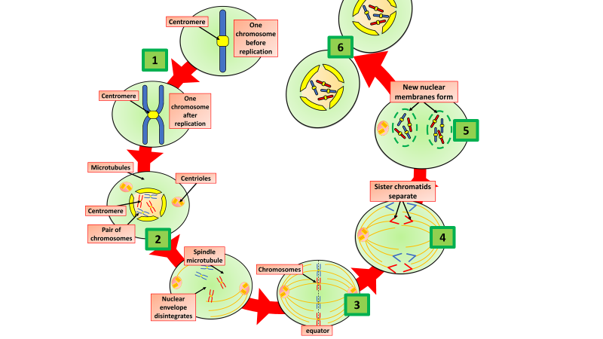
Mitosis & Meiosis
Specification Link:
Inheritance: 4.6.1.2
Highlight key words in the information below:
Mitosis is cell division which produces two identical diploid cells for growth and repair. Differentiation occurs when cells become specialised. Stem cells can develop into different cell types.
The first stages of the cell cycle involve cell growth, then synthesis of new DNA , to replicate the original DNA. The single strand of DNA that makes up each chromosome produces an exact copy of itself. In mitosis, two cells called daughter cells are produced, each identical to the parent cell.
In mitosis why do the chromosomes need to replicate?
________________________________________________________________________________
Highlight key words in the information below:
Sexual reproduction uses the process of meiosis , which creates gametes . These are sperm and eggs (ova) in animals, and pollen and ova in plants. The process of meiosis happens in the male and female reproductive organs. .the cell divides twice to form four gametes, each with a single set of chromosomes.
Meiosis is a type of cell division that reduces the number of chromosomes in the parent cell by half and produces four gamete cells. This process is required to produce egg and sperm cells for sexual reproduction.
In mitosis what role is played by spindle fibres?
________________________________________________________________________________
Compare the number of chromosomes in daughter cells to it’s parent cell in mitosis
________________________________________________________________________________
Meiosis and mitosis are different types of division in human cells. Compare the two processes by referring to where each takes place and the kind of products that are made.
________________________________________________________________________________________________________________________________________________________________________________________________________________________________________________________________________________________________________________________________________________________________________________________________________________________________________________________________________________________________________________________________________________________________________________________________________________________________________________________________
The questions below all refer to meiosis
What is crossing over?
________________________________________________________________________________
What sort of cells are made?
________________________________________
Describe what happens to chromosomes
________________________________________________________________________________
Compare the number of chromosomes at the start to the number of chromosomes at the end
________________________________________________________________________________

