Slide 1

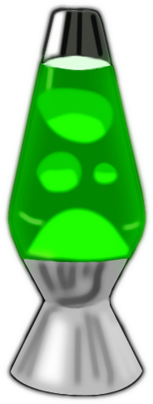
Make an Easy Lava Lamp
Introduction
Learn how to make an easy lava lamp with this fun science experiment for kids. Use simple household items such as vegetable oil, food coloring, Alka-Seltzer and a bottle to create chemical reactions and funky balls of color that move around like a real lava lamp.
What’s Happening
If you've tried our oil and water experiment you'll know that the two don't mix very well. The oil and water you added to the bottle separate from each other, with oil on top because it has a lower density than water. The food coloring falls through the oil and mixes with the water at the bottom. The piece of Alka-Seltzer tablet you drop in after releases small bubbles of carbon dioxide gas that rise to the top and take some of the colored water along for the ride. The gas escapes when it reaches the top and the colored water falls back down. The reason Alka-Seltzer fizzes in such a way is because it contains citric acid and baking soda (sodium bicarbonate), the two react with water to form sodium citrate and carbon dioxide gas (those are the bubbles that carry the colored water to the top of the bottle).
Instructions:
Pour water into the plastic bottle until it is around one quarter full (you might want to use a funnel when filling the bottle so you don't spill anything).
Pour in vegetable oil until the bottle is nearly full.
Wait until the oil and water have separated.
Add around a dozen drops of food coloring to the bottle (choose any color you like).
Watch as the food coloring falls through the oil and mixes with the water.
Cut an Alka-Seltzer tablet into smaller pieces (around 5 or 6) and drop one of them into the bottle, things should start getting a little crazy, just like a real lava lamp!
When the bubbling stops, add another piece of Alka-Seltzer and enjoy the show!
What you'll need:
Water
A clear plastic bottle
Vegetable oil
Food coloring
Alka-Seltzer (or other tablets that fizz)
Reflection Questions
Is something confusing me?
Could I explain this to someone else?

