Slide 1

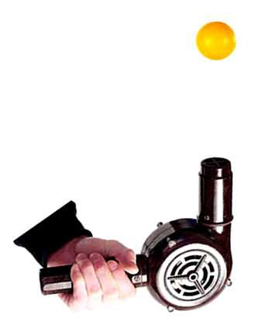
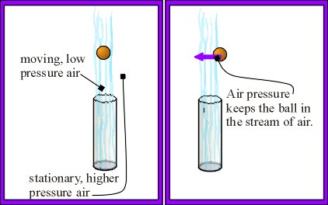
Make a Ping Pong Ball Float
Introduction
Can you control a ping pong ball as it floats above a hair dryer? Put your hand-eye coordination skills to the test while learning the important role that forces such as gravity and air pressure play in this simple experiment for kids.
What you'll need:
At least 1 ping pong ball (2 or 3 would be great)
A hair dryer
What’s Happening
Your ping pong ball floats gently above the hair dryer without shifting sideways or flying across the other side of the room. The airflow from the hair dryer pushes the ping pong ball upwards until its upward force equals the force of gravity pushing down on it. When it reaches this point it gently bounces around, floating where the upward and downward forces are equal.
The reason the ping pong ball stays nicely inside the column of air produced by the hair dryer without shifting sideways is due to air pressure. The fast moving air from the hair dryer creates a column of lower air pressure, the surrounding higher air pressure forces the ping pong ball to stay inside this column, making it easy to move the hair dryer around without losing control of the ping pong ball.
Instructions:
Plug in the hair dryer and turn it on.
Put it on the highest setting and point it straight up.
Place your ping pong ball above the hair dryer and watch what happens.
Reflection Questions
Is something confusing me?
Could I explain this to someone else?

