Slide 1

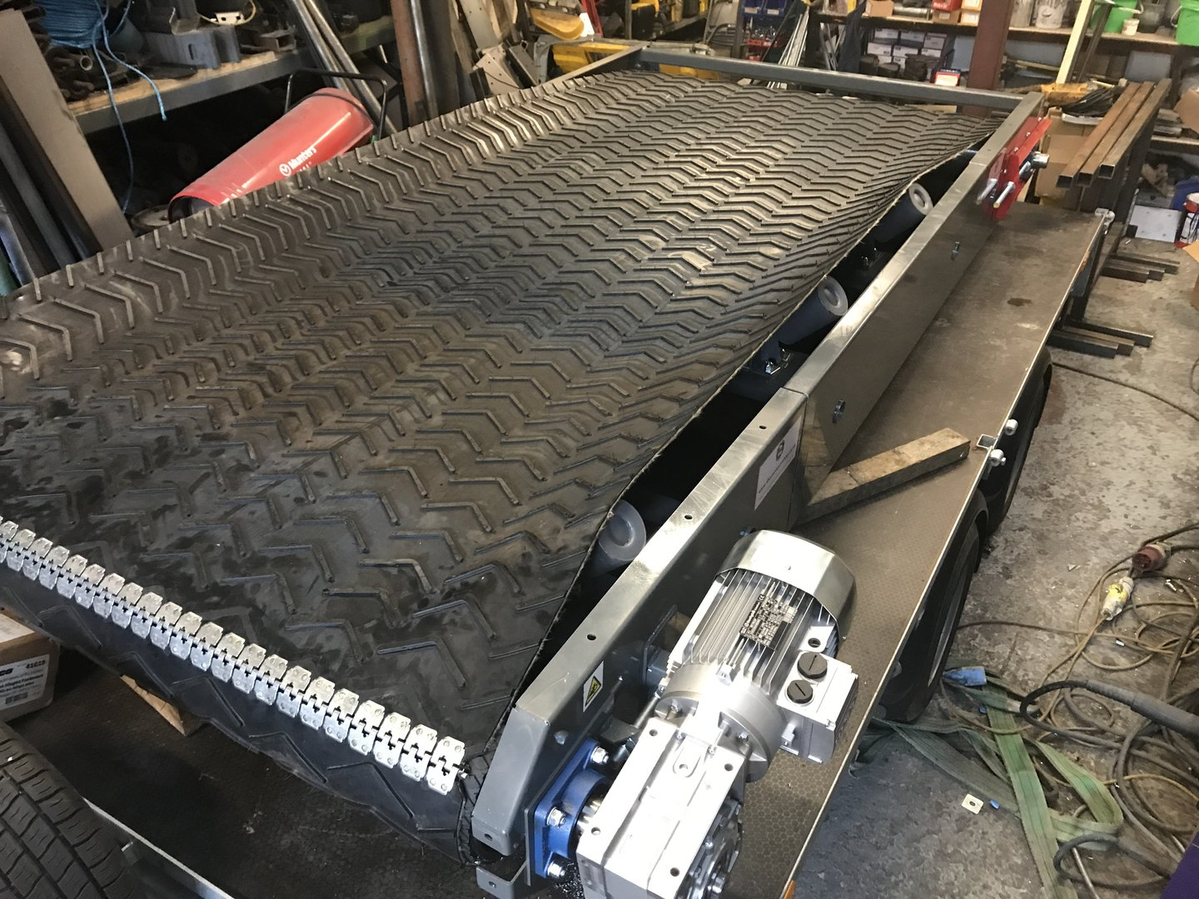
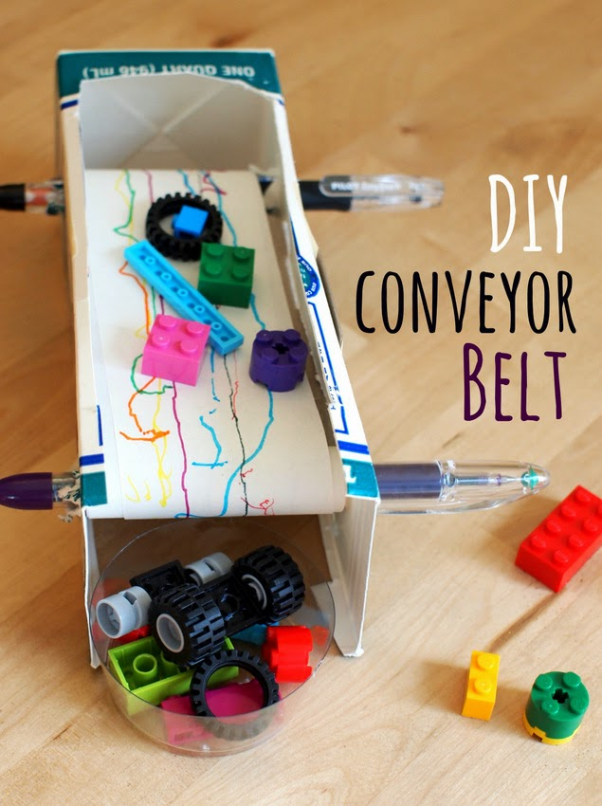
STEM: Make a Conveyor Belt
Introduction
One of the basic tools in material handling industry, belt conveyors are most commonly used in transportation of bulk materials (grain, salt, coal, ore, sand, etc.). Belt conveyor systems consist of two or more pulleys (a.k.a. drums). An endless loop of carrying medium the conveyor belt— rotates about them..
Your Challenge!
Design and build a small conveyer belt to transport lego bricks from one are to another. Try and make your conveyer belt as long as possible and remember it needs to move!
What you'll need:
Glue
Paper
Cardboard
Pens
Things to think about
Reflection Questions
How will you make it turn?
How long will you make it?
How wide will you make it?
How will your wrap the paper around the pens?
How will you make it look like a conveyer belt?
What should I do first?
Is something confusing me?
Where can I look for help?
How can I do it better?

