Slide 1
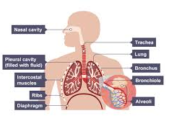
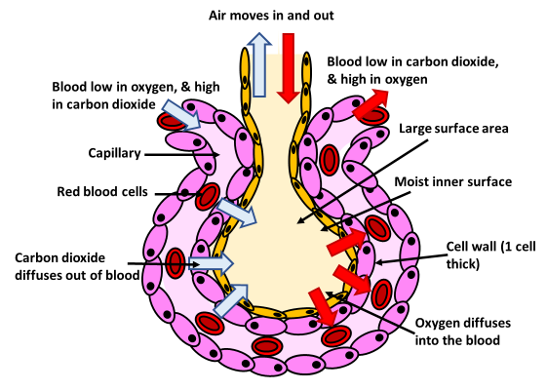
The Lungs
Specification Link:
Biological Organisation
How air is sucked in and forced out
____________________________________________________________________________________________________________________________________________________________________________________________________________________________________________________________________________________________________________________________________________________________________________________________________________________________________________________________________________________________________________________________________
Describe how each of the following increases gas exchange:
Good ventilation?
_________________________________________________________________________________________________________________________________________________________________________________________
Good circulation?
____________________________________________________________________________________________________________________________________________________
A large surface area?
_________________________________________________________________________________________________________________________________________________________________________________________
Moist surface?
____________________________________________________________________________________________________________________________________________________
Short diffusion distance?
_________________________________________________________________________________________________________________________________________________________________________________________
Describe in detail how blood becomes oxygenated in the lungs:
__________________________________________________________________________________________________________________________________________________________________________________________________________________________________________________________________________________________________________________________________________________________________________________________________________________________________________________________________________________________________________________________________________________________________________________________________________________________

