Slide 1
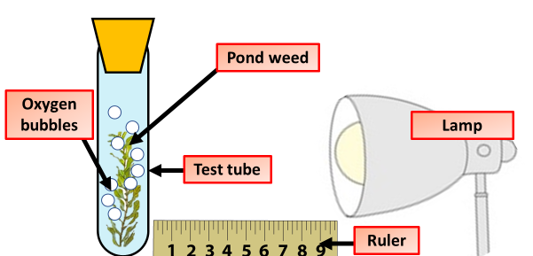
Key Words
Leaf
Light
Chlorophyll
Oxygen
Photosynthesis
Y7 Bio 2
AO: Data presentation
Before the lesson highlight key words or phrases in the information below
Introduction:
Green plants absorb light energy using chlorophyll in their leaves. They use it to react carbon dioxide with water to make a sugar called glucose. The glucose is used in respiration, or converted into starch and stored. Oxygen is produced as a by-product. This process is called photosynthesis. Temperature, carbon dioxide concentration and light intensity are factors that can limit the rate of photosynthesis
Photosynthesis is the chemical change which happens in the leaves of green plants. It is the first step towards making food - not just for plants but ultimately every animal on the planet.
During photosynthesis:
Light energy is absorbed by chlorophyll, a green substance found in chloroplasts in some plant cells and algae
Absorbed light energy is used to convert carbon dioxide (from the air) and water (from the soil) into a sugar called glucose
Oxygen is released as a by-product.
Photosynthesis equation:
Method:
Set up a test tube rack containing a boiling tube at a distance of 10 cm away from the light source
Fill the boiling tube with the sodium hydrogen carbonate solution.
Put the piece of pondweed into the boiling tube with the cut end at the top. Gently push the pondweed down with the glass rod.
Leave the boiling tube for 5 minutes.
Start the stop watch and count the number of bubbles produced in one minute.
Repeat the count twice more. Then use the data to calculate the mean number of bubbles per minute.
Repeat steps 1‒7 with the test tube rack and boiling tube at distances of 20 cm, 30 cm and 40 cm from the light source.
Results
Distance between pondweed and light source in cm | Number of bubbles per minute
 | 1 | 2 | 3 | Mean
10
20
30
40

Slide 2
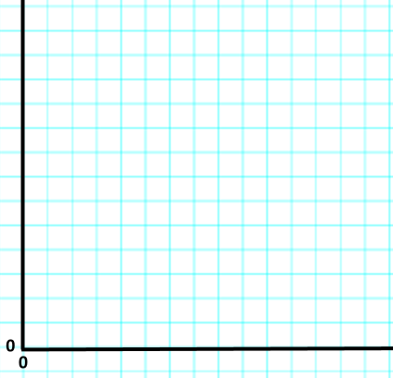
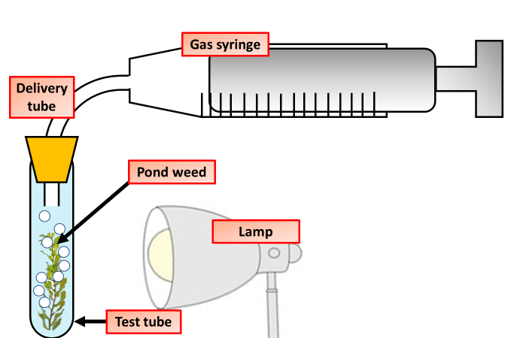

Key Words
Leaf
Light
Chlorophyll
Oxygen
Photosynthesis
Y7 Bio 2
AO: Data presentation
On the graph paper below, draw a graph showing the results of your experiment
How to get marks when drawing graphs:
Labelled axis
Units on axis
Correct scale used on axis
Points using means plotted correctly
An appropriate line of best fit
Any anomalous results circled
Follow the link below to a video which will help you complete the task to the right
The diagram above shows a different set of equipment to measure the rate of photosynthesis. Explain how this equipment would give you more precise results:
______________________________________________________________________________________________________________________________________________________________________________________________________________________________________________________

