Slide 1
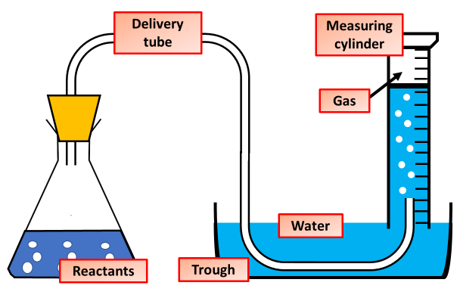
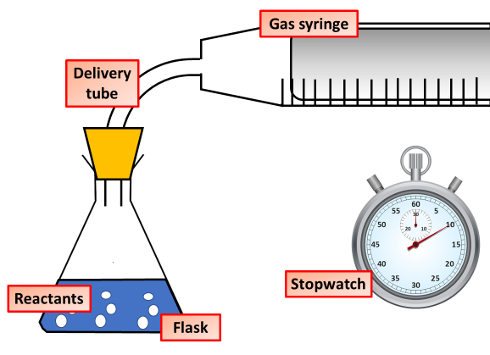
Investigations Involving Gas
Specification Link:
Describe how the equipment in the diagram to the left can be used to measure gas produced during a practical
____________________________________________________________________________________________________________________________________________________________________________________________________________________________________________________________________________________________________________________________________________________________________________________________________________
What possible errors could there be in the results?
______________________________________________________________________________________________________________________________________________________________________________________________________________________________
Highlight key words or phrases
Method
Support a gas syringe with a stand, boss and clamp.
Using a measuring cylinder, add 50 cm3 of dilute hydrochloric acid to a conical flask.
Add 0.4 g of calcium carbonate to the flask. Immediately connect the gas syringe and start a stop clock.
Every 10 seconds, record the volume of gas produced.
When the reaction is complete, clean the apparatus as directed by a teacher.
Repeat steps 1 to 5 with different concentrations of hydrochloric acid.
Explain how using the equipment above would give more precise results
_________________________________________________________________________________________________________________________________
What is the independent variable?
____________________________________
Describe how you can tell that the reaction is complete. ____________________________________________________________________________________________________________________________________________________________________________
What is the dependent variable?
____________________________________
What is the control variable?
____________________________________

