Slide 1
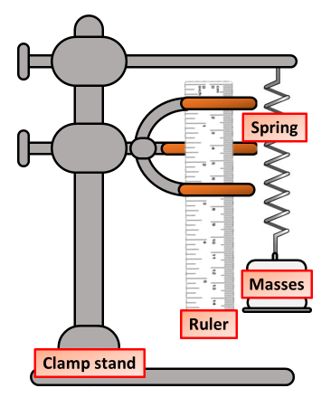
Measuring forces around you, Variables, Reliability & Accuracy
Hooke’s Law Planning Activity
Y7 Science Introduction
Introduction: Use the method below and your own knowledge to answer the questions about this investigation
Attach the spring to the of a top clamp, and a ruler to the bottom clamp.
Measure and record the unloaded length of the spring.
Hang a 100 g slotted mass carrier. Measure and record the new length of the spring.
Add a 100 g slotted mass to the carrier. Measure and record the new length of the spring.
Repeat step 7 until you have added a total of 1,000 g.
Dependent variable:______________________
Independent variable:______________________
Range:_____ to ________
Interval:________
Control variable:______________________
Hooke’s Law Planning Activity
Y7 Science Introduction
Introduction: Use the method below and your own knowledge to answer the questions about this investigation
Attach the spring to the of a top clamp, and a ruler to the bottom clamp.
Measure and record the unloaded length of the spring.
Hang a 100 g slotted mass carrier. Measure and record the new length of the spring.
Add a 100 g slotted mass to the carrier. Measure and record the new length of the spring.
Repeat step 7 until you have added a total of 1,000 g.
Dependent variable:______________________
Independent variable:______________________
Range:_____ to ________
Interval:________
Control variable:______________________

