Slide 1

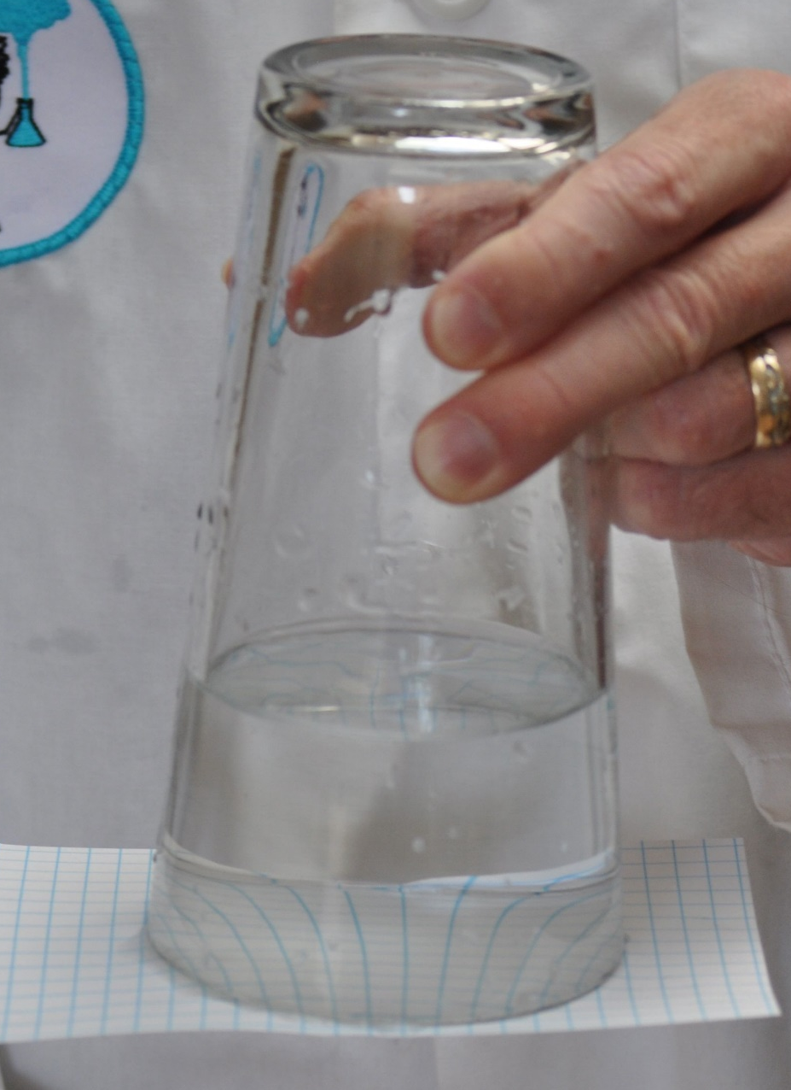
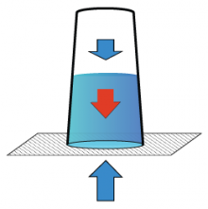
Gravity Free Water
Introduction
What goes up must come down right? Well try bending the rules a little with a cup of water that stays inside the glass when held upside down. You'll need the help of some cardboard and a little bit of air pressure.
What you'll need:
A glass filled right to the top with water
A piece of cardboard
Instructions:
Put the cardboard over the mouth of the glass, making sure that no air bubbles enter the glass as you hold onto the cardboard.
Turn the glass upside down (over a sink or outside until you get good).
Take away your hand holding the cardboard.
What’s Happening
If all goes to plan then the cardboard and water should stay put. Even though the cup of water is upside down the water stays in place, defying gravity! So why is this happening? With no air inside the glass, the air pressure from outside the glass is greater than the pressure of the water inside the glass. The extra air pressure manages to hold the cardboard in place, keeping you dry and your water where it should be, inside the glass.
Diagram showing the relevant forces on the water. The blue arrows indicate the forces due to air pressure above and below the water. The red arrow indicates the force of gravity. Together, the three forces balance out to cancel each other.
Reflection Questions
Is something confusing me?
Could I explain this to someone else?

