Slide 1

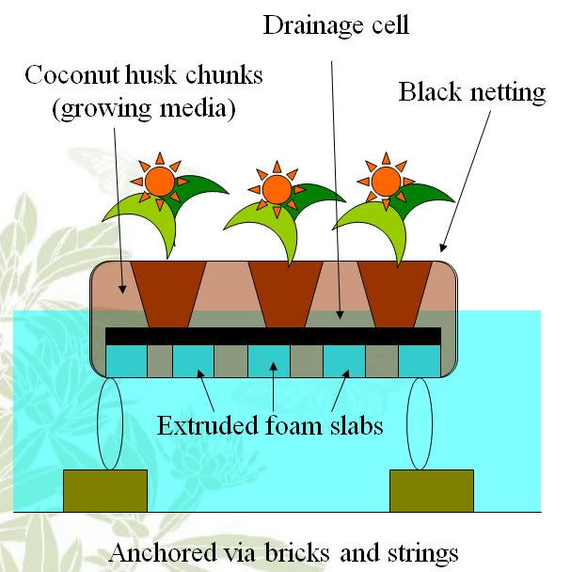
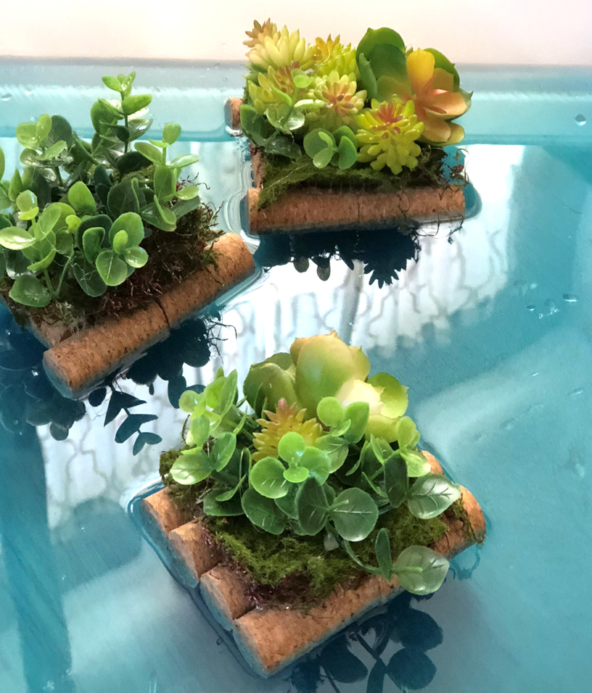
STEM: Floating Gardens
Introduction
Bangladesh faces severe problems as a consequence of storms, cyclones and floods. The ancient practice of floating gardens - beds of straw and water hyacinths on which crops are grown - is making a comeback in the face of increased floods.
Your Challenge!
Your challenge is to design and build a model of a structure that people can grow their crops on, even when their land becomes flooded.
You will be asked to present your work to the rest of your class and to test your model to see how well it floats!
Things to think about
You will need to think about:
whether you want your model to float and if so, how you can make it do so.
how to make the top of your model suitable to grow crops on. Does it need to be flat? Layered?
the size of your model. It needs to be tested by placing it on water in a washing up bowl or sink.
Reflection Questions
What should I do first?
Is something confusing me?
Could I explain this to someone else?
Where can I look for help?
How can I do it better?

