Slide 1
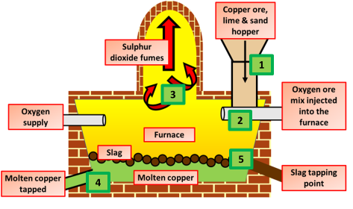
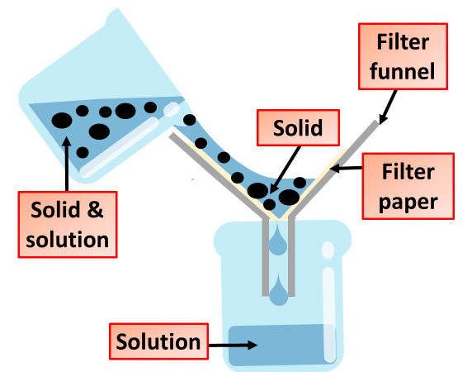
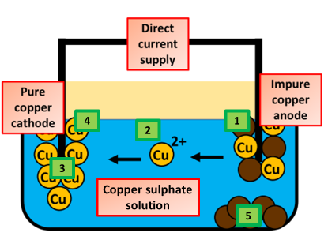
Extracting Copper
Specification Link:
Chemical Changes
Highlight key words in the information below:
If a metal is less reactive than carbon, it can be extracted from its compounds by heating with carbon. Copper is an example of this. Copper mostly occurs as sulfide ores, which are heated in air to convert them to copper(II) oxide. Molten copper can be produced from copper oxide by heating with carbon. Copper oxide is reduced as carbon is oxidised, so this is an example of a redox reaction.
Describe how copper can be obtained by the process of smelting
__________________________________________________________________________________________________________________________________________________________________________________________________________________________________________________________________________________________
To make copper sulphate start off by reacting excess copper oxide with sulphuric acid. Filter the impurities out. Evaporate water from the copper sulphate solution so as to get a saturated solution. Cover the solution with a filter paper and leave it undisturbed at room temperature to cool slowly for a day. You will obtain the crystals of copper sulphate in the china dish
Write a step by step method for how to produce copper sulphate
__________________________________________________________________________________________________________________________________________________________________________________________________________________________________________________________________________________________________________________________________________________________________________________________________________________________________________________________________
Remembering the process of electrolysis, describe how copper can be purified
___________________________________________________________________________________________________________________________________________________________________________________________________________________________________________________________________________________________________________________________________________________________________________________________________

