Slide 1
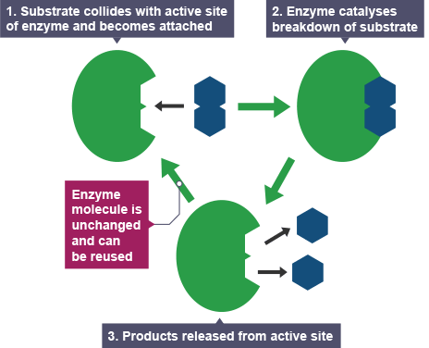
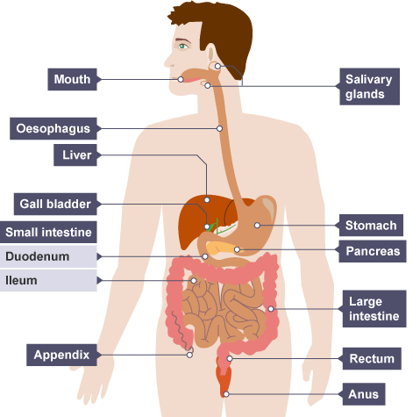
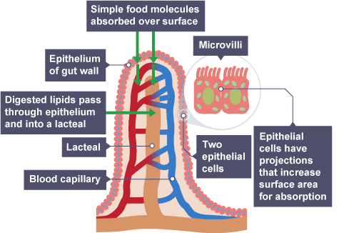
Enzymes & Digestion
Specification Link:
Biological Organisation
What are enzymes?
_________________________________________________________________________________________________________________________________
What is the function of a carbohydrase?
_________________________________________________________________________________________________________________________________
What is the function of a lipase?
_________________________________________________________________________________________________________________________________
What happens in the mouth (focus on enzymes)
___________________________________________________________________________________________________________________________
What happens in the stomach (focus on enzymes)
___________________________________________________________________________________________________________________________
What happens in the intestines (focus on enzymes)
_____________________________________________________________________________________________________________________________________________________________________________________________________________
How do villi increase surface area?
_________________________________________________________________________________________________________________________________
Describe how nutrients are absorbed by villi
__________________________________________________________________________________________________________________________________________________________________________________________________________________________________________________________________

