Slide 1

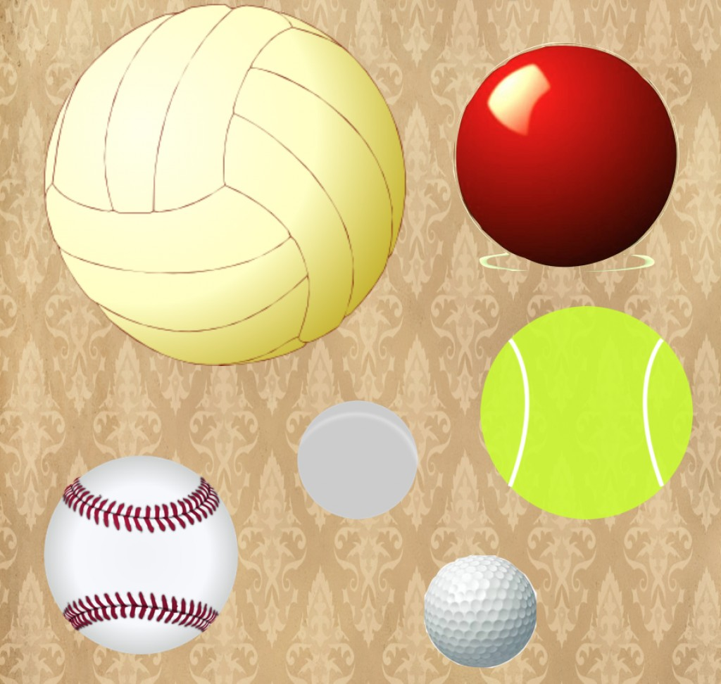
Energy Transfer through Balls
Introduction
Energy is constantly changing forms and transferring between objects, try seeing for yourself how this works. Use two balls to transfer kinetic energy from the the big ball to the smaller one and see what happens.
What you'll need:
A large, heavy ball such as a basketball or soccer ball
A smaller, light ball such as a tennis ball or inflatable rubber ball
What’s Happening
If you dropped the balls at the same time, the tennis ball should bounce off the basketball and fly high into the air. The two balls hit each other just after they hit the ground, a lot of the kinetic energy in the larger basketball is transferred through to the smaller tennis ball, sending it high into the air.
While you held the balls in the air before dropping them they had another type of energy called 'potential energy', the balls gained this through the effort it took you to lift the balls up, it is interesting to note that energy is never lost, only transferred into other kinds of energy.
Instructions:
Make sure you're outside with plenty of room.
Carefully put the tennis ball on top of the basketball, holding one hand under the basketball and the other on top of the tennis ball.
Let go of both the balls at exactly the same time and observe what happens.
Reflection Questions
Is something confusing me?
Could I explain this to someone else?

