Slide 1
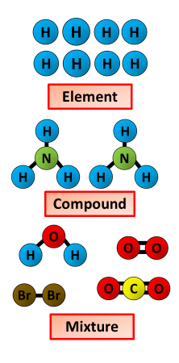
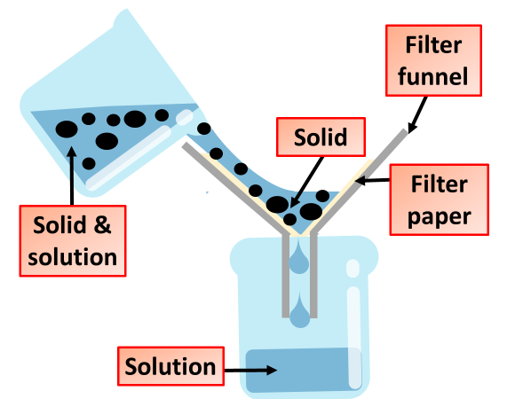
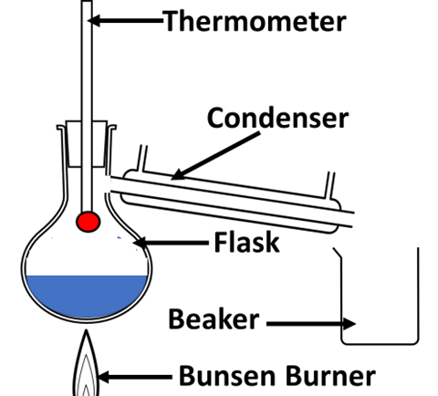
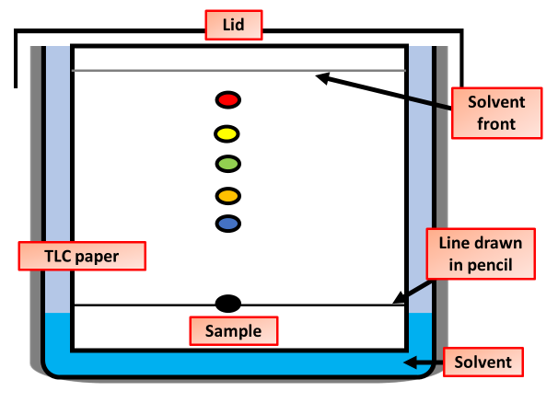
Elements, Mixtures, Compounds & Separation
Specification Link:
Atoms & the Periodic Table
What is an element?
________________________________________________________________________________________________________________________
What is a compound?
________________________________________________________________________________________________________________________
What is a mixture?
________________________________________________________________________________________________________________________
Highlight key words in the information below:
Filtration is technically defined as the process of separating suspended solid matter from a liquid, by causing the latter to pass through the pores of a membrane, called a filter. The most common example is making of tea. While preparing tea, a filter or a sieve is used to separate tea leaves from the water.
Describe how a solid and a liquid can be separated
____________________________________________________________________________________________________________________________________________________________________________________________________________________________________
Distillation is the process of separating the components or substances from a liquid mixture by using selective boiling and condensation. Distillation may result in essentially complete separation, or it may be a partial separation that increases the concentration of selected components in the mixture
Describe how two substances can be separated by distillation
____________________________________________________________________________________________________________________________________________________________________________________________________________________________________
Chromatography is a laboratory technique for the separation of a mixture. The mixture is dissolved in a fluid called the mobile phase, which carries it through a structure holding another material called the stationary phase. The various constituents of the mixture travel at different speeds, causing them to separate.

