Slide 1
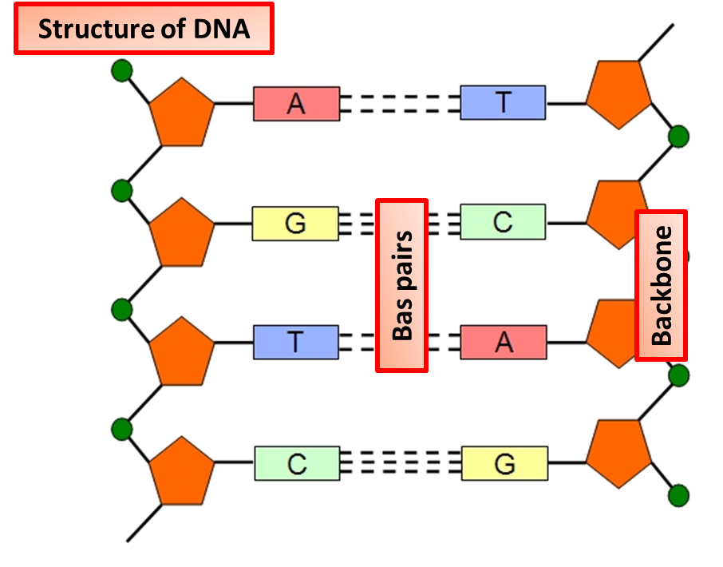
DNA & the Genome
Specification Link:
Inheritance: 4.6.1.2
Highlight key words in the information below:
DNA molecules are large and complex. They carry the genetic code that determines the characteristics of a living organism. Except for identical twins, each person’s DNA is unique. This is why people can be identified using DNA fingerprinting. DNA can be cut up and separated, forming a sort of 'bar code' that is different from one person to the next.
As embryos develop, some genes in cells are turned off and some genes are turned on. This allows cells to become specialised for particular functions. What is a gene?
________________________________________________________________________________________________________________________________________________________________
Highlight key words in the information below:
Each strand of DNA is made of chemicals called bases. Note that these are different to bases in relation to acids and alkalis in chemistry. There are four different bases in DNA:
thymine, T
adenine, A
guanine, G
cytosine, C
There are chemical cross-links between the two strands in DNA, formed by pairs of bases. They always pair up in a particular way, called complementary base pairing:
thymine pairs with adenine (T–A)
guanine pairs with cytosine (G–C)
Describe where DNA is found in a human cell.
________________________________________________________________________________
Complete the following sentence.
The letters A, C, G and T in the diagram represent four different compounds called
________________________________________
Highlight key words in the information below:
The genome of an organism is the entire genetic material of that organism. Each of your diploid body cells (not sperm, eggs or red blood cells) has one copy of your entire genome.
The Human Genome Project started in 1990 and was completed in 2003. Hundreds of scientists from different universities all over the world collaborated together to determine the sequence of base pairs that made up the genome of a random man and woman. There are more than three billion of these! This was a huge moment in the history of biology, and one that showed the importance of working together and sharing scientific information.
The mapping of the whole human genome has great importance for medicine. In order to exploit its secrets, it is vital that the human genome is fully understood.
What is the human genome project?
_______________________________________________________________________________
Describe what we can find out from the human genome project
________________________________________________________________________________________________________________________________________________________________________________________________________________________________________________________________________________________________________________________________

