Slide 1

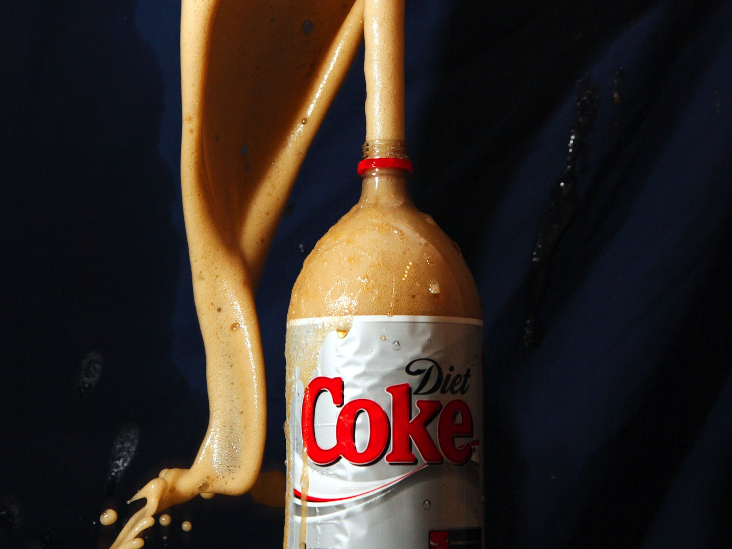
Diet Coke & Mentos Eruption
Introduction
One of the most popular experiments of modern times is the Diet Coke and Mentos Geyser. Made popular by Steve Spangler, this experiment is a lot of fun and sure to amaze your friends and family (assuming you do it outside rather than in the living room).
What you'll need:
Large bottle of Diet Coke
About half a pack of Mentos
Geyser tube (optional but makes things much easier)
What’s Happening
Although there are a few different theories around about how this experiment works, the most favoured reason is because of the combination of carbon dioxide in the Diet Coke and the little dimples found on Mentos candy pieces.
The thing that makes soda drinks bubbly is the carbon dioxide that is pumped in when they bottle the drink at the factory. It doesn't get released from the liquid until you pour it into a glass and drink it, some also gets released when you open the lid (more if you shake it up beforehand). This means that there is a whole lot of carbon dioxide gas just waiting to escape the liquid in the form of bubbles.
Dropping something into the Diet Coke speeds up this process by both breaking the surface tension of the liquid and also allowing bubbles to form on the surface area of the Mentos. Mentos candy pieces are covered in tiny dimples (a bit like a golf ball), which dramatically increases the surface area and allows a huge amount of bubbles to form.
Instructions:
Make sure you are doing this experiment in a place where you won't get in trouble for getting Diet Coke everywhere. Outside on some grass is perfect, please don't try this one in your family lounge!!
Stand the Diet Coke upright and unscrew the lid. Put some sort of funnel or tube on top of it so you can drop the Mentos in at the same time (about half the pack is a good amount). Doing this part can be tricky if you don't have a specially designed geyser tube, I recommend buying one from a local store such as Natures Discoveries (NZ) or online.
Time for the fun part, drop the Mentos into the Diet Coke and run like mad! If you've done it properly a huge geyser of Diet Coke should come flying out of the bottle, it's a very impressive sight.
Reflection Questions
Is something confusing me?
Could I explain this to someone else?

