Slide 1
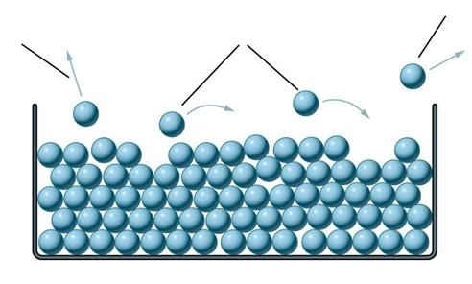
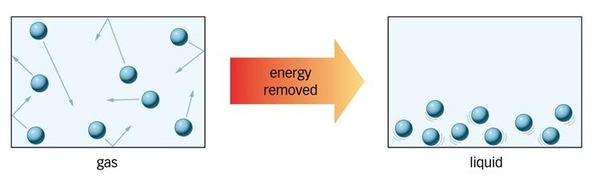
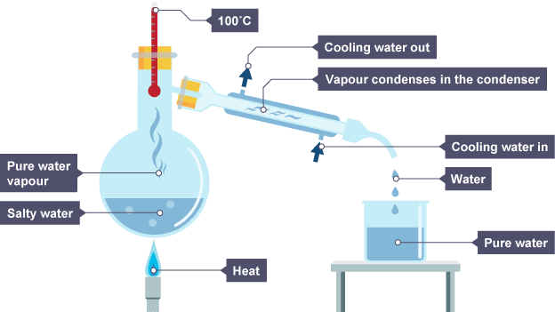
Desalination Question
Specification Link:
Highlight key words in the information below:
What is pure water?
____________________________________________________________________________________________________________________________________________________________________
Pure water, also known as purified water, is water from a source that has removed all impurities. Distilled water is the most common form of pure water. Pure water can be purified by carbon filtration, micro-porous filtration and ultraviolet oxidation. Some places use a combination of purification processes.
Describe what happens during evaporation
_____________________________________________________________________________________________________________________
Explain what happens during condensation
_____________________________________________________________________________________________________________________
What is desalination?
__________________________________________________________________________________________
Desalination is a process that removes minerals from saline water. More generally, desalination refers to the removal of salts and minerals from a target substance, as in soil desalination, which is an issue for agriculture. Saltwater is desalinated to produce water suitable for human consumption or irrigation.
Distillation is a process of separating the component substances from a liquid mixture by selective evaporation and condensation. Distillation may result in essentially complete separation (nearly pure components), or it may be a partial separation that increases the concentration of selected components of the mixture.
What is distillation?
__________________________________________________________________________________________
Describe how pure water can be produced
____________________________________________________________________________________________________________________________________________________________________________________________________________________________________________________________________________________________________________________________________________________________________________________
Describe how the equipment to the left could be used to measure the rate of photosynthesis:
_______________________________________________________________________________________________________________________________________________________________________________________________________________________________________________________________

