Slide 1
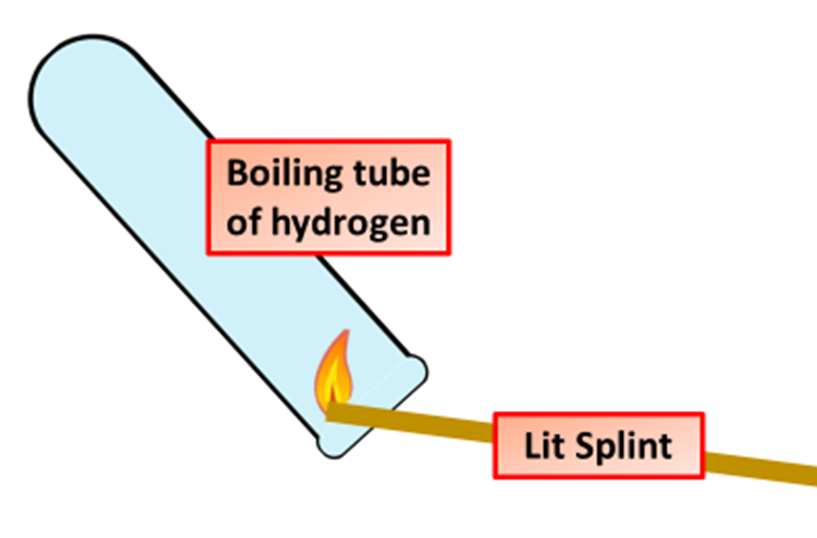
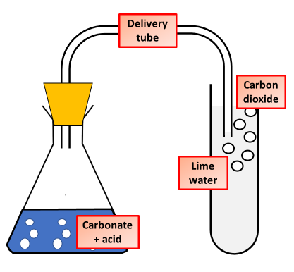
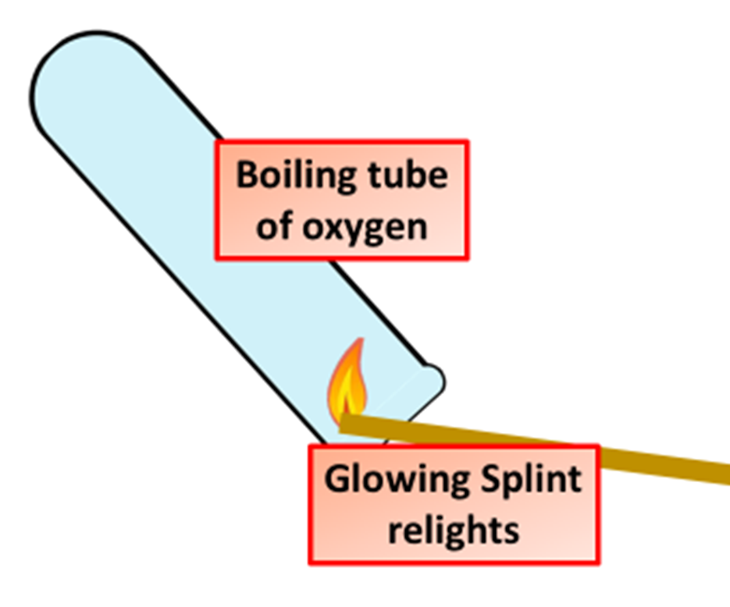

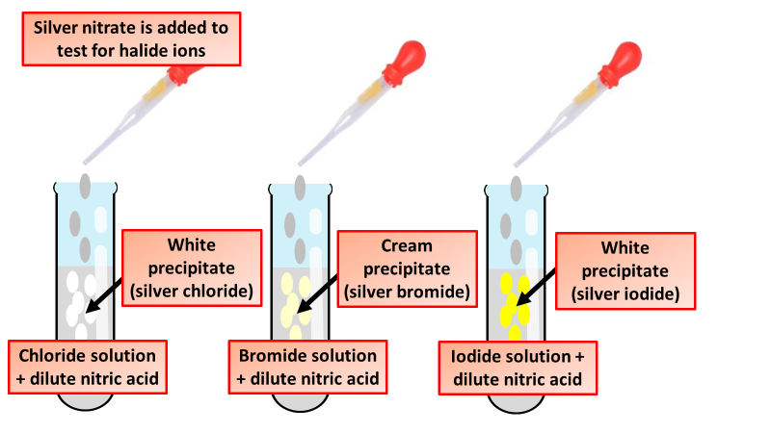
Chemical Analysis Tests
Specification Link:
Chemical Analysis
Describe the test that would give a positive result for hydrogen gas
________________________________________________________________________________________________________________________________________________________________________________________________________________________________________________________________
Describe how carbon dioxide gas can be tested for and what would a positive result be?
_________________________________________________________________________________________________________________________________________________________________________________________________________________________________________________________________________
Describe the test that would give a positive result for oxygen gas
____________________________________________________________________________________________________________________________________________________________________________________________________________________________________________________________________________________________________________
Describe the test for the detection of chlorine, and what would a positive result look like?
______________________________________________________________________________________________________________________________________________________________________________
Describe how halides can be tested for, and what results would different halides give?
________________________________________________________________________________________________________________________________________________________________________________________________________________________________________________

