Slide 1

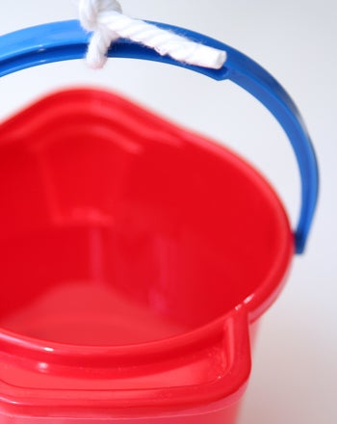
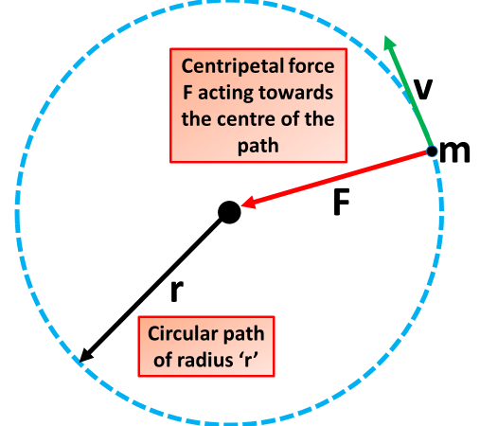
Bucket Spinning
Introduction
You might think that an upside down bucket of water above your head would end up with you getting very wet but what if the bucket is spinning quickly in a circular motion? Give this fun science experiment for kids a try and see what happens while learning a thing or two about centripetal force.
What you'll need:
A reliable bucket with a strong handle
Water
An open area outside where spilling some water is ok.
What’s Happening
There's half a bucket of water spinning upside down above your head and yet it's not falling out and getting you wet, what's going on?
This experiment makes use of something called 'centripetal force', which is a force acting on an object moving in a circular path, directed towards the center around which it is moving. This type of force can also be seen on roller coasters or by satellites in orbit around a planet.
As you spin the bucket you might feel that it wants to fly off in a straight line away from you (you might even accidentally let go of it), this is a demonstration of Newton's first law of motion, that an object will continue in a straight line unless an outside force (in this case your arm) acts upon it.
Instructions:
Fill the bucket until it is around half full with water.
Stand well clear of other people or anything else that could get in the way.
Hold the bucket by its handle with your arm extended and start spinning it by your side towards the sky and back to the ground in a circular motion, make sure to spin it fast enough to keep the water inside the bucket. Be prepared to get a little wet as your technique improves.
Stop spinning before your arm gets tired, watching out for splashes as you carefully bring the bucket back to rest on the ground.
Reflection Questions
Is something confusing me?
Could I explain this to someone else?

