Slide 1

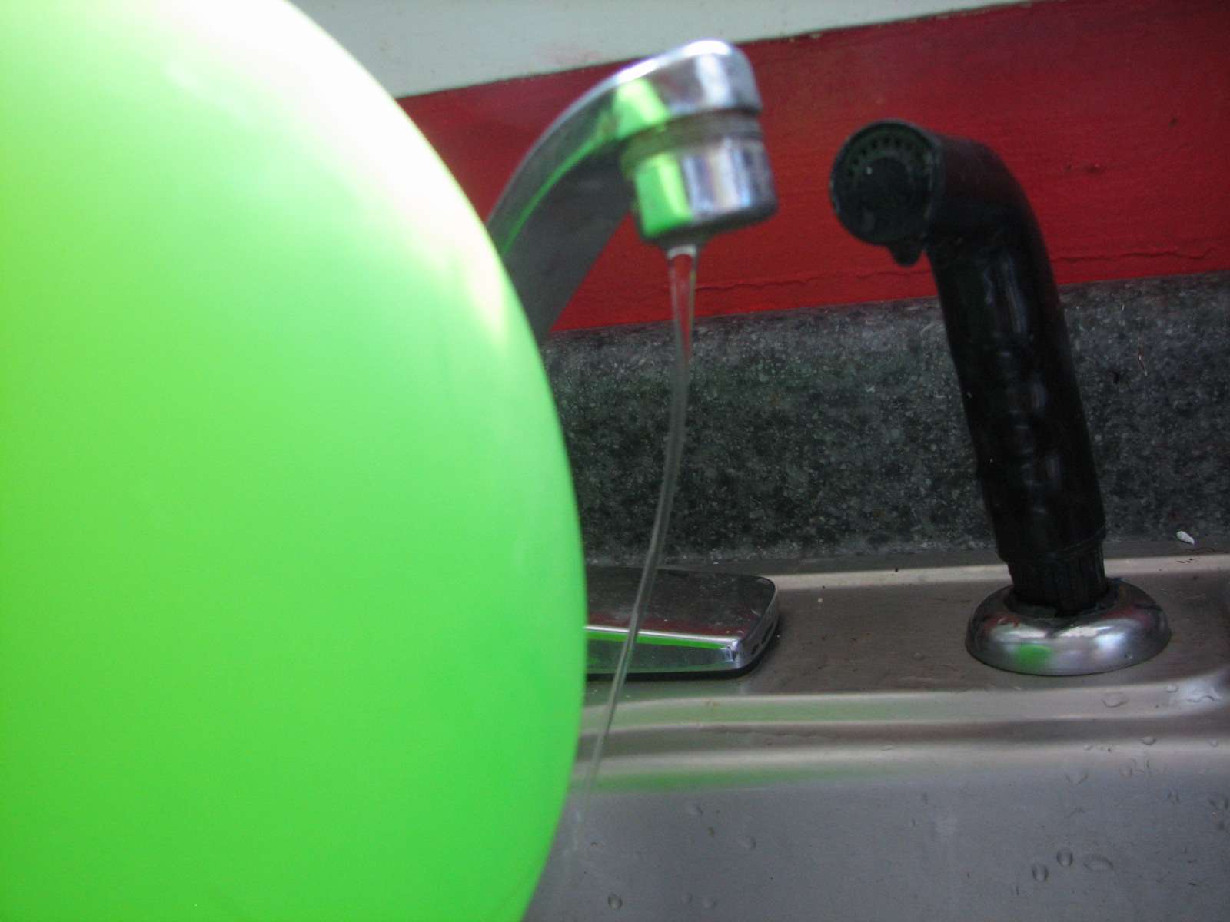
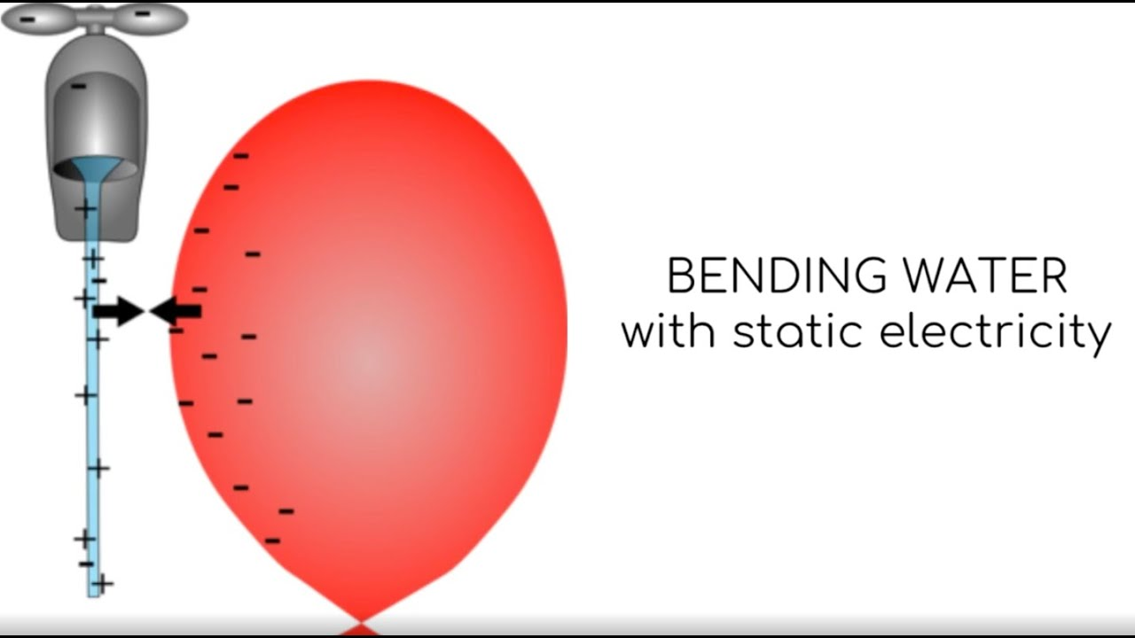
Bending Water with Static
Introduction
Here’s an easy science experiment that’s great for helping kids learn about static electricity. Try bending water with static electricity produced by combing your hair or rubbing it with an inflated balloon, can it really be done? Give it a try and find out!
What you'll need:
A plastic comb (or an inflated balloon)
A narrow stream of water from a tap
Dry hair
What’s Happening
The static electricity you built up by combing your hair or rubbing it against the balloon attracts the stream of water, bending it towards the comb or balloon like magic!
Negatively charged particles called electrons jump from your hair to the comb as they rub together, the comb now has extra electrons and is negatively charged. The water features both positive and negatively charged particles and is neutral. Positive and negative charges are attracted to each other so when you move the negatively charged comb (or balloon) towards the stream, it attracts the water's positively charged particles and the stream bends!
Instructions:
Turn on the water so it is falling from the tap in a narrow stream (just a few millimetres across but not droplets).
Run the comb through your hair just as you normally would when brushing it (do this around 10 times). If you are using a balloon then rub it back and forth against your hair for a few seconds.
Slowly move the comb or balloon towards the stream of water (without touching it) while watching closely to see what happens.
Reflection Questions
Is something confusing me?
Could I explain this to someone else?

