Slide 1

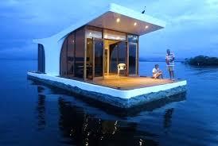
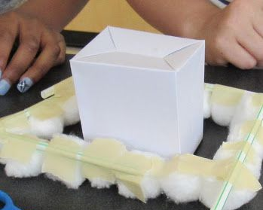
STEM: Beat the Flood
Introduction
Floating houses are permanently in the water, while amphibious houses are situated above the water and are designed to float when the water levels rise. If the water level rises, they can move upwards and float. The fastenings to the mooring posts limit the motion caused by the water..
Your Challenge!
Design a home for your community on a low lying Island able to withstand the effects of flooding, and make a model of your design so you can test it.
Reflection Questions
What should I do first?
Things to think about
Is something confusing me?
How will you make your house float?
How will you cut down on the wight of the house?
How are you going to provide your house with electricity?
How are you going to make sure your house doesn’t float off?
How will you provide your house with clean water?
Could I explain this to someone else?
Where can I look for help?
How can I do it better?
Can I explain the importance of each part?
Do I know why it might be important to think about floating houses?

