Slide 1

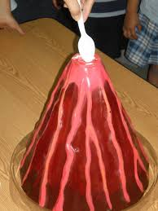
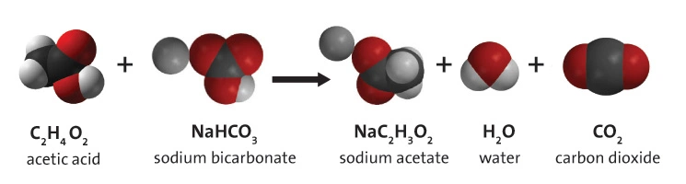
Baking Soda & Vinegar Volcano
Introduction
Use baking soda and vinegar to create an awesome chemical reaction! Watch as it rapidly fizzes over the container and make sure you've got some towels ready to clean up.
The baking soda (sodium bicarbonate) is a base while the vinegar (acetic acid) is an acid. When they react together they form carbonic acid which is very unstable, it instantly breaks apart into water and carbon dioxide, which creates all the fizzing as it escapes the solution.
What you'll need:
Baking Soda (make sure it's not baking powder)
Vinegar
A container to hold everything and avoid a big mess!
Paper towels or a cloth (just in case)
What’s Happening
The baking soda (sodium bicarbonate) is a base while the vinegar (acetic acid) is an acid. When they react together they form carbonic acid which is very unstable, it instantly breaks apart into water and carbon dioxide, which creates all the fizzing as it escapes the solution.
For extra effect you can make a realistic looking volcano. It takes some craft skills but it will make your vinegar and baking soda eruptions will look even more impressive!
Instructions:
Place some of the baking soda into your container.
Pour in some of the vinegar
Watch as the reaction takes place!

