Slide 1
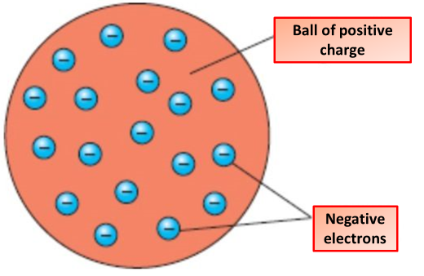
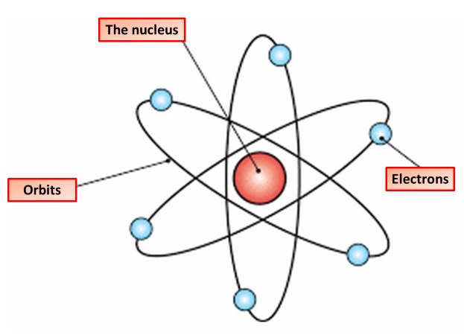
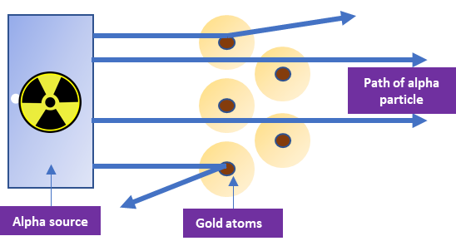
Atomic Theory
Specification Link:
Atoms & the Periodic Table
Highlight key words in the information below:
The Plum Pudding Model is a model of atomic structure proposed by J.J. Thomson in the late 19th century. Thomson had discovered that atoms are composite objects, made of pieces with positive and negative charge, and that the negatively charged electrons within the atom were very small compared to the entire atom.
How is the plumb pudding model different from the current model of the atom?
_________________________________________________________________________________________________________________________________________________________________________________________________________________________________________________________________________
The structure of an atom, theoretically consisting of a positively charged nucleus surrounded and neutralized by negatively charged electrons revolving in orbits at varying distances from the nucleus, the constitution of the nucleus and the arrangement of the electrons differing with various chemical elements.
Describe the structure of an atom using the atomic theory
____________________________________________________________________________________________________________________________________________________________________________________________________________________________________________________________________________________________________________________________________________________________________________________________________________________________________
Rutherford overturned Thomson's model in 1911 with his well-known gold foil experiment in which he demonstrated that the atom has a tiny and heavy nucleus. Rutherford designed an experiment to use the alpha particles emitted by a radioactive element as probes to the unseen world of atomic structure.
Rutherford's experiment utilized positively charged alpha particles (He with a +2 charge) which were deflected by the dense inner mass (nucleus). The conclusion that could be formed from this result was that atoms had an inner core which contained most of the mass of an atom and was positively charged
How was the experiment set up?
_______________________________________________________________________________________________________________________________________________________________________________________________________________________
How was it proven that most of an atom is empty space?
_________________________________________________________________________________________________________________________________

