Slide 1
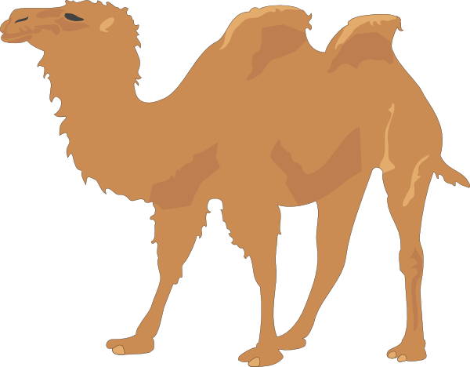
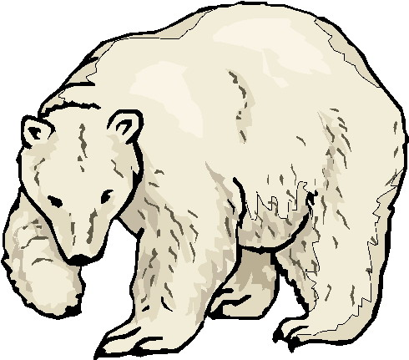
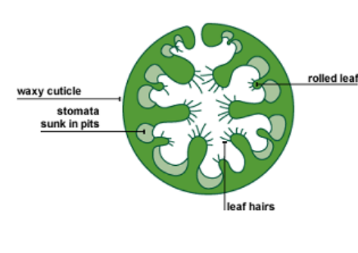
Adaptations
Specification Link
Ecology:
Summarize the adaptations of camels:
Three more adaptations of the camel are given in the diagram. Give a reason why each adaptation helps the animal survive in the desert.
Fat store
____________________________________________
Produces little urine and very dry faeces
____________________________________________
Produces no sweat
____________________________________________
Summarize the adaptations of polar bears:
Explain how polar bears survive in the cold
________________________________________________________________________________________________________________________________________________________________________________________________________________________________________________________________________________________________________________________________________________________________
Summarize the adaptations of a cactus:
The concentration of carbon dioxide in the Earth’s atmosphere is rising. The rise in carbon dioxide concentration may cause more of the Earth’s surface to become desert. The diagram shows a plant that is adapted to life in a hot, dry desert. Suggest two ways in which the structure of the plant helps it to survive in a hot, dry desert.
________________________________________________________________________________________________________________________________________________________________________________________________________________________________________________________________________

