Slide 1
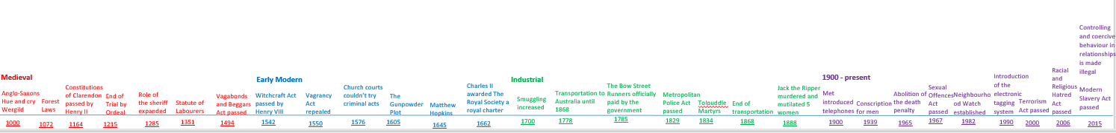
Question 2b Exam practice
Learning objectives:
To practise writing 4 mark source follow up answers.
Do now: Copy out the following exam question
How could you follow up Source B to find out more about the problems facing immigrants in the Whitechapel area? [4 marks]
5 minutes

Slide 2
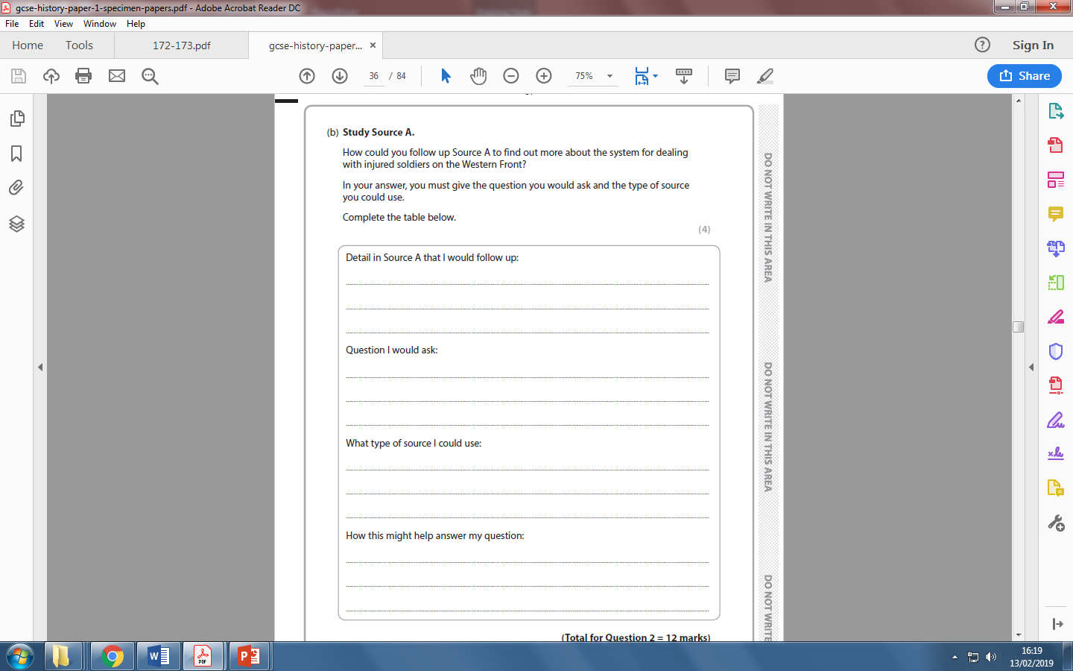
Exam practise: Question 2b
Q2b: How could you follow up Source B to find out more about …? (4 marks)
Your final question in section A will ask you four small questions about a source worth 1 mark each.
This question has “gateway” steps.
It is one mark per point.
For example if you do not answer the “Question I would ask” but you answered the “what type of source you would use – you would not be awarded any marks.

Slide 3
How could you follow up source B to find out more about Ms Bearcroft’s hobbies? [4 marks]
10 minutes
Source B: Ms. Bearcroft’s memoirs, dated 12th April 2017.
I spent 1 week in Poland during half term 2 years ago. It was quite cold and I went to many historical places because I love history so much. The weather was not very good as it was February.
Notes:
Complete with class
Detail: ‘Went to many historical places.’
Question: ‘What does Ms Bearcroft do on hoilday??’
Type of source: Ms. Bearcroft’s Instagram account
How this might help: She might have posted about to kinds of places she visited which may give more information about what she is interested in.

Slide 4
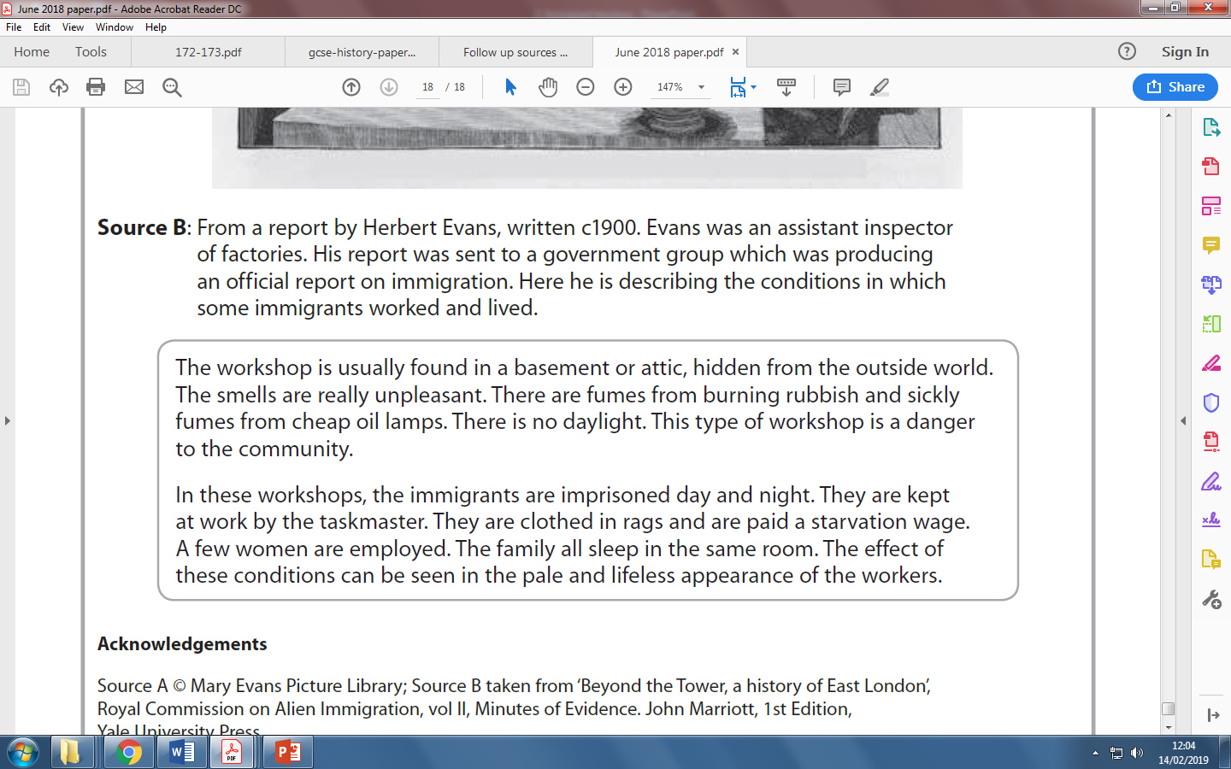
How could you follow up Source B to find out more about the problems facing immigrants in the Whitechapel area? [4 marks]
10 minutes
Notes:
Print for students

Slide 5
How could you follow up Source B to find out more about the problems facing immigrants in the Whitechapel area? [4 marks]
‘Imprisoned day and night’
What would the immigrants be doing in the workshop and how badly are they being treated?
Notes:
Answers

Slide 6
Class model: How would you follow up…
How could you follow up Source B to find out more about the problems facing immigrants in the Whitechapel area? [4 marks]
10 minutes
Task:
Read over the source and highlight any details related to the enquiry (problems facing immigrants)
Do any of these details prompt further questions that would give you more information on the enquiry?
Select just one detail that you feel confident you could follow-up.
Notes:
• Detail in Source B that I would follow up: the statement that they were paid starvation wages (1).
• Question I would ask: Why could they not find a better paid job? (1).
• What type of source I would look for: council records showing what businesses there were in the area (1).
• How this might help answer my question: it would help me to understand what options were available for workers to find employment (1).

Slide 7
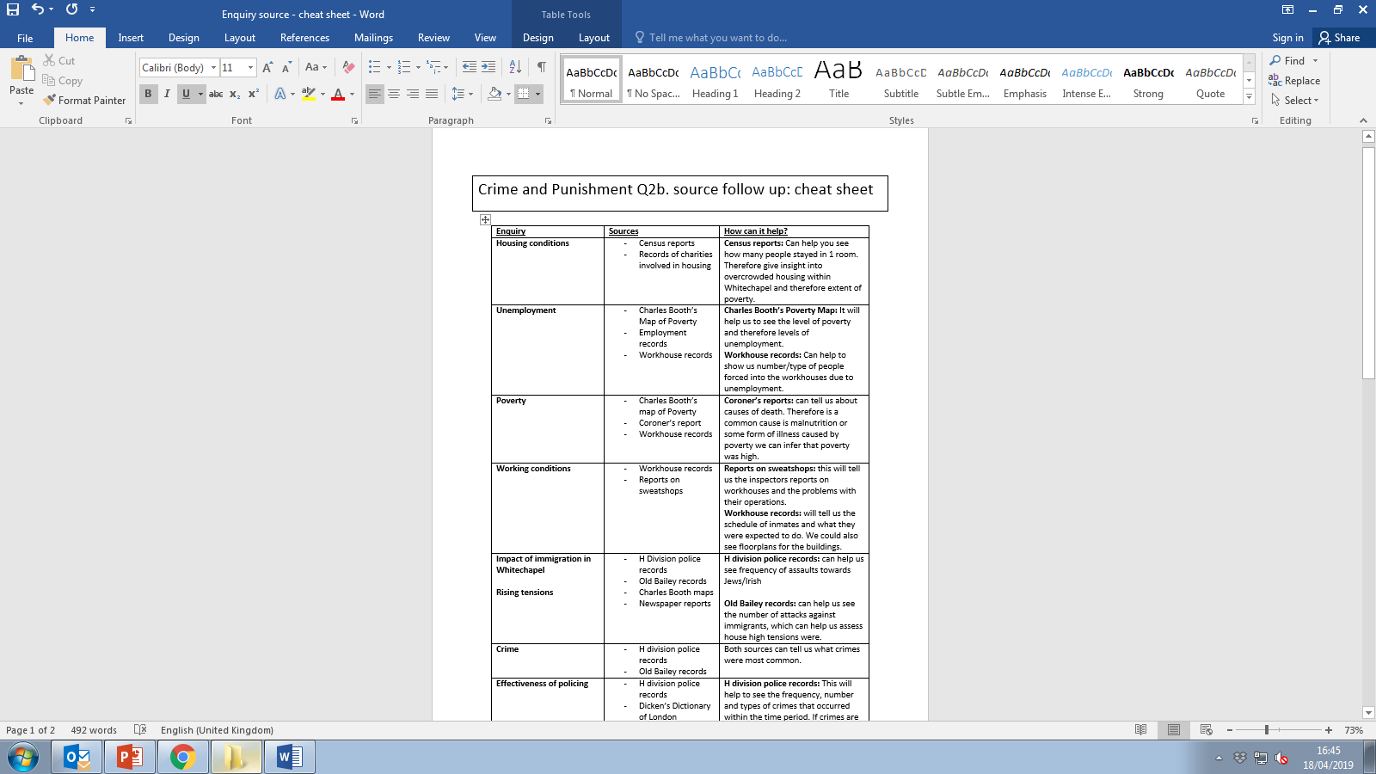
Sources: Cheat sheet
Task:
1. Use your Source Cheat sheet to decide what source you could use to help to answer your question.
2. Use the cheat sheet to help you figure out how this source would provide the information that you need?
10 minutes
Notes:
Print from doc folder and glue into front/back of book.

Slide 8
How could you follow up Source B to find out more about the problems facing immigrants in the Whitechapel area? [4 marks]
‘Imprisoned day and night’
What would the immigrants be doing in the workshop and how badly are they being treated?
A diary of an immigrant who was working in Whitechapel at the time
The diary will provide the detail to what they were doing day to day in the workshop. This will allow us to see how badly they were treated.
Notes:
answers

Slide 9
Plenary
5 minutes
What source would he useful to tell you about the publics’ attitude to the police? Why?

