Slide 1
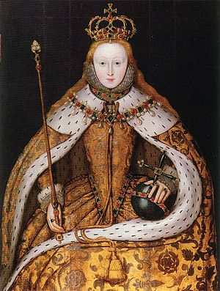
Elizabeth in 1558:
expectations
and problems

Slide 2
Elizabeth’s early life
Put these events from Elizabeth’s early life into the correct chronological order:
Elizabeth is threatened by execution
The arrest of Thomas Seymour
The death of Henry VIII
Elizabeth is interrogated in Edward’s reign
Elizabeth learns she is queen
Elizabeth’s flirtation with Thomas Seymour
Elizabeth’s imprisonment in the Tower
Henry’s marriage to Catherine Parr
The execution of Thomas Seymour
Henry’s marriage to Jane Seymour
Elizabeth is interrogated in Mary’s reign
The birth of Elizabeth
The birth of Edward
The execution of Anne Boleyn
(SHP pg 14)

Slide 3
What does this interpretation tell us about Elizabeth’s character and approach to rule?
‘Elizabeth acceded to the throne at the age of 25, significantly younger than Mary had been at her accession. There were however, considerable differences in character and experience between the two. Elizabeth was considerably better educated, had a much shrewder grasp of political processes in their widest sense, and was, for the most part, a shrewder judge of character than her half sister. She had also learned much from her personal and political experiences, including a brief and tempestuous relationship with Thomas Seymour, and what may have been her treasonable implications in Wyatt’s rebellion.
Elizabeth showed the development of her political skill at the result of each of these developments. Her succinct dismissal of the executed Thomas Seymour as a man of much wit but little judgement showed that she had learnt from the temporary disgrace of her relationship. Her clear-headedness under interrogation and marking a letter to Mary with diagonal lines so that it could not be doctored were remarkable for someone aged 20.
Elizabeth clearly believed that she was entitled to rule the Kingdom directly, and from the start of her reign it was clear who was in charge. In December 1558, the Spanish Ambassador, the Count of Feria, noted that Elizabeth was more feared than her sister and gave orders as ‘absolutely as her father did.’
Elizabeth had no desire to involve herself I the details of government in the manner of her grandfather, Henry VII. However, she took an informed interest in decision making processes. More importantly she was determined to preserve the prerogative powers of the Crown, which meant she insisted on taking the most important decisions. On coming to the throne, she had a number of short term aims:
To consolidate her position. 2. Settle religious disputes. 3. Pursue peace with France.’
Tillbrook, The Tudors: England 1485-1603, 2015

Slide 4
What does this interpretation tell us about Elizabeth’s character and religious beliefs?
‘Elizabeth the politician and Elizabeth the person can never be disentangled, but some things can be concluded about her preferences. In the matter of religion, she was a Protestant. Although it is difficult to tell exactly what theology she preferred, it is obvious that she would not tolerate a Church independent from the state. The royal supremacy was at the very centre of both her political and religious ideals. Elizabeth gained a reputation from being a conservative in matters of church ceremony and decoration, if not dogma, but this only became obvious after the Parliament of 1559. She was a Protestant but tolerant towards Catholic behaviour. To say that she preferred a bit of colour in her religion and had a good opinion of Mary, the mother of Christ does not mean, however, that Elizabeth rejected the Second Common Book of Prayer, or the theology espoused by the Swiss Protestant reformers.’
Adapted from N Jones, Faith by Statute: Parliament and the Settlement of religion, 1559, 1982

Slide 5
Problems in 1558
Handout (pg 27-28 SHP book)
Colour-code according to how serious and urgent the problem was – more serious/urgent, less serious / urgent
Which problems are linked?

Slide 6
How might Elizabeth have dealt with her problems?
Pg 30-31 SHP
This activity gives you a good sense of the main issues from the beginning of the reign and gets you starting to think about why she made some key decisions.
Work through the decisions in pairs and come up with reasons to support your choices.

Slide 7
The body of the queen (schama)

