Slide 1






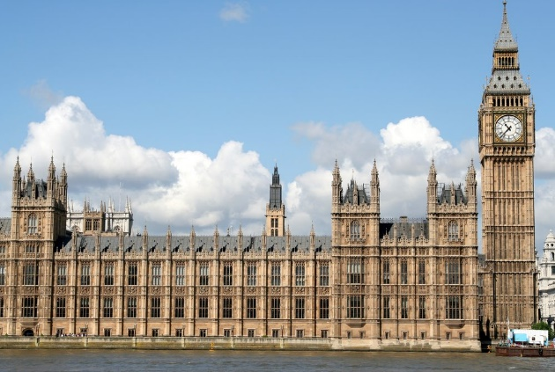

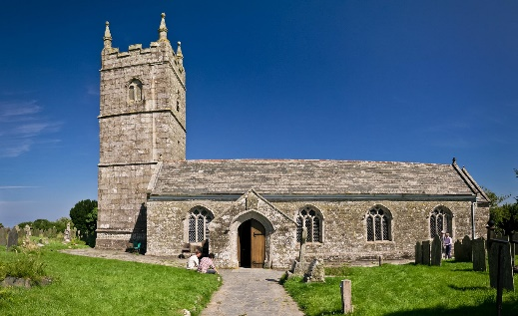
Miss Norgrove
Can you work out what these words are?
ECONOMY
RELIGION
POLITICS
Notes:
Students to write their own definition in books with pictures if necessary

Slide 2
Miss Norgrove
Tuesday 31st January 2017
Why was the Church so powerful?
ECONOMY
RELIGION
POLITICS
Notes:
Students to write their own definition in books with pictures if necessary

Slide 3
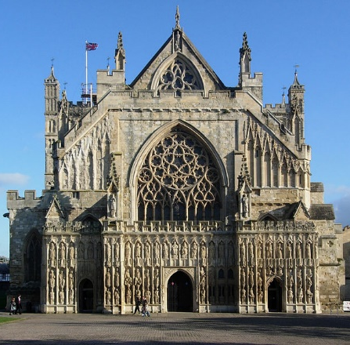
Miss Norgrove
Why was the Church so powerful?
To know the meaning of Economic, Religious and Political
To prioritise the reasons from most important to least important
To categorise the reasons into Economic, Religious and Political

Slide 4
What did you learn last lesson?
Think- Pair- Share
Notes:
Think- pair- share activity
Pose
Pause
Pounce
Bounce

Slide 5
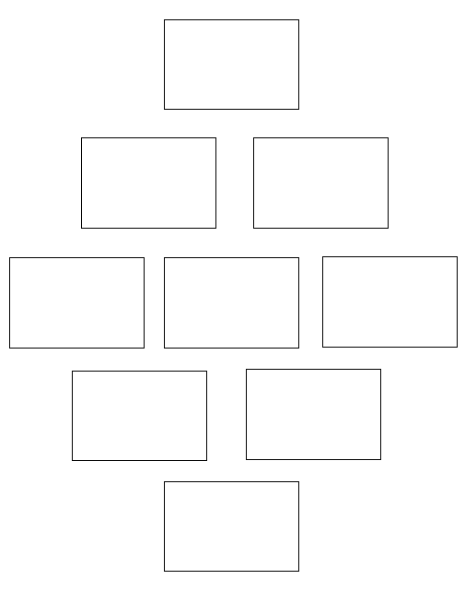
Diamond Nine!
The most important reason why the Church was so powerful
The least important reason why the Church was so powerful
Miss Norgrove
Notes:
Differentiate Task?
Individual and then speak to the person next to them
Glue reasons into book

Slide 6
Big Enquiry:
How much power did the Church have in the Middle Ages?
Target Grade | Task | Challenge
1-4 | Colour in all of the Economic factors for why the Church was so powerful | Colour in all of the Religious factors
5-6 | Colour in all of the Economic and Religious factors for why the Church was so powerful | Colour in all of the Political factors

Slide 7
Q: Why was the Church so powerful?
I think the Church was powerful in the Middle Ages because of…..
Economical
Political
Religious
reasons. This is because the Church would (list reasons) _______
______________________________________________________________________________________________________________. This would make the Church powerful because _________ _____________________________________________________
_____________________________________________________

Slide 8
Goodbye my name is ____________ and one thing that I have learnt in today’s lesson is……….

