Slide 1
Announcements
VLE resources
Revision Plan
Expectations and Student success

Slide 2

The Evolution of Crime:
Petty theft to cyber fraud
A thematic look at the changes and continuities of crime

Slide 3
Defining Crime
What is a crime?
Short answer: any illegal behaviour
But, what decides illegal behaviour?
The law… an act becomes a crime when there is a relevant law in place that dictates the act is illegal.
Notes:
Therefore, to commit the act once a law restricting it comes in place it is a crime, to which you are open to prosecution, trial and penalty. (Can use the example of poaching – before the forest laws, poaching was just hunting, but afterward, hunting
For this reason, we will be looking at the crimes through the course and the corresponding laws that create the crimes

Slide 4
Medieval England,
1000-1500

Slide 5
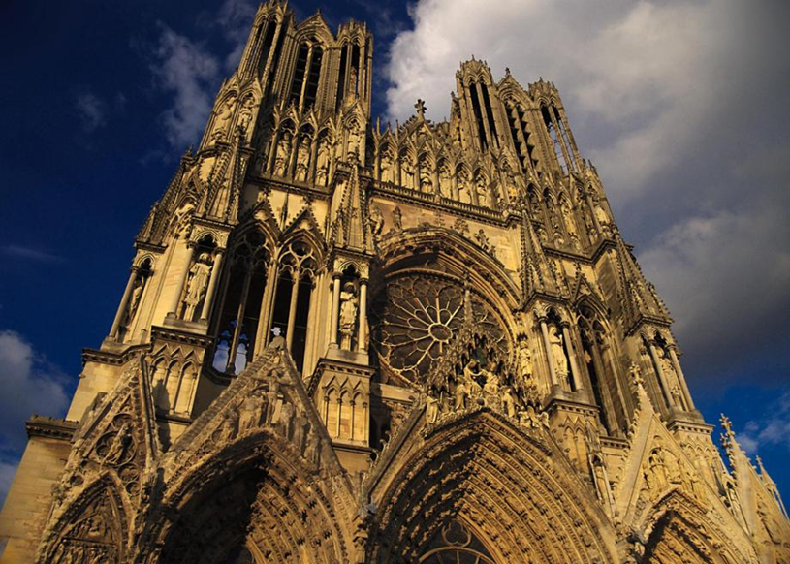
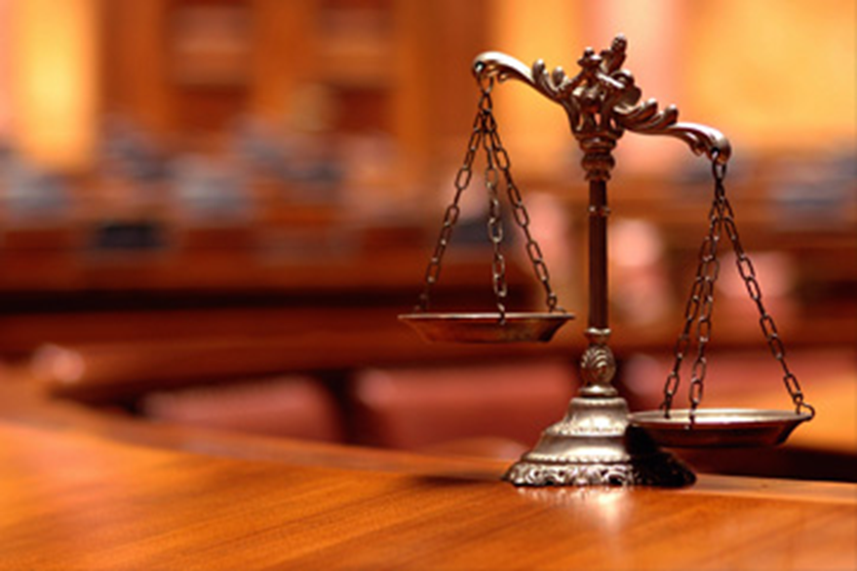
Blurred Lines
In a time when sin and crime are basically the same thing, finding a solid definition for crime is challenging.
Notes:
An additional challenge to defining crime, which as we’ve already stated is defined by law, in a time where there are frequent changes to the law due to new monarchs and ways of ruling the country…uncertainty is consistent

Slide 6
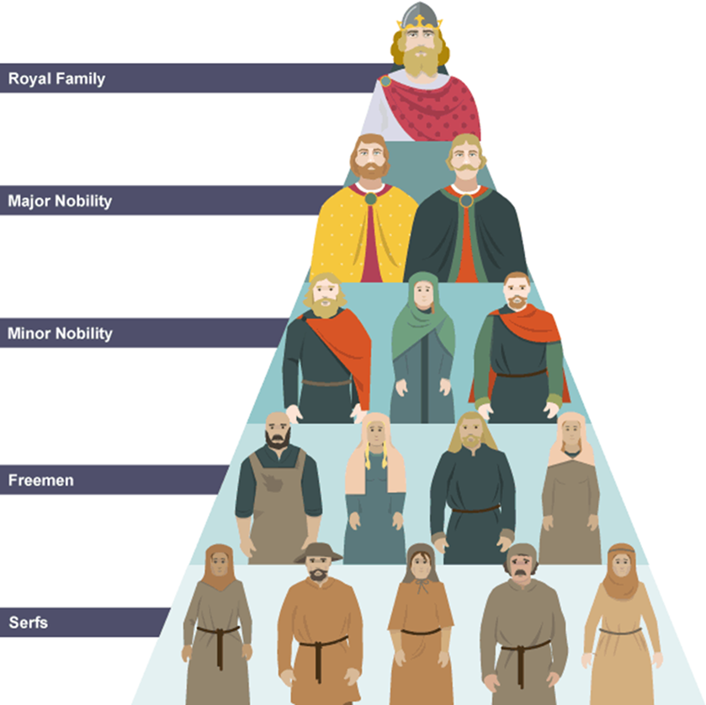
Role of the King in law making
Previously, communities had their own laws, so crime and punishment was very basic and relied on local customs.
As the authority of the king increased, so did his role in law making and enforcement.
The King’s Peace – the Anglo-Saxon believe that it was the King’s duty to take care of law and order
Notes:
The King’s Peace – the Anglo-Saxon believe that it was the King’s duty to take care of law and order.
The idea is that people could carry out their daily lives, knowing that the law will be upheld by the king.
This social structure is important to note, because as the structure changes, so do laws and crimes

Slide 7
Medieval Crimes
Match the crime to the definition type
Which type of crime is most common?
Types of Crime
Crimes against the person
Any crime that causes physical harm to another person
Crimes against property
A crime which involves taking or damaging something that belongs to another person
Crimes against authority
A crime which threatens the social structure of the time
Moral Crimes
Crimes which don’t physically hurt anyone or their property , but doesn’t match up to society's views on decent behaviour
Treason
Assault
Theft
Adultery
Extortion
Arson
Fighting a noble
Murder
Drunkenness
Coining
Betraying your Lord

Slide 8
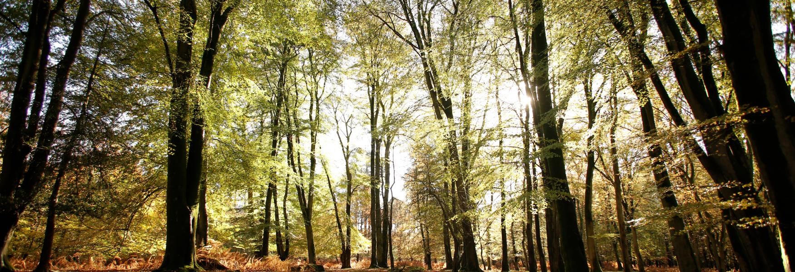
A new King, a new law
William I (1066), by claiming large stretches of land part of the ‘royal forest’, and making hunting and gathering materials from the forest illegal, created the FOREST LAWS
Poaching – illegal hunting on land that belongs to someone else
Poaching – our first look at ‘social crimes’

Slide 9
Crimes in the Later Middle Ages
Statute of Labourers
Heresy
The Black Death, 1348
1/3 of the population dies
Peasants demand higher wages
Ruling class worried
Statute of Labourers, 1351
People questioned the Church
Church feels threated and undermined
Laws against heresy (1382, 1401, 1414)
Notes:
In this era, we see 2 new crimes emerge within the topic
During the black death, the plague killed 1/3 of the population of England. This created a real problem for the agricultural way of life as there was a shortage of labourers. Those lucky enough to survive were now expected to pick up the slack. The labourers demanded higher wages for their extra work.
Fearing the labouring class would get too wealthy and try to take control, parliament introduced the Statute of Labourers which made it a crime to ask for money or to move to another area to look for better paid work.
Continuity to Normans is seen as ruling class introduces new laws to protect their own interests.
Change as the new laws were now being passed by government and not the king alone.
In the 13th and 14th century, a small number of people started questioning the church and wanted change – they disagreed with the sacrament of bread and wine and wanted the bible in English for all to read. The church felt undermined and threatened. Laws against heresy were first introduced in 1382. in 1401, burning at the stake was introduced.
Heresy Laws are an example of church and state working together – medieval kings were happy to support the church to squash any deviation from the established religion as it supports that deviation from the king/state will also not be tolerated. In 1414, the amended law gave Justices of the Peace authority to arrest suspect heretics, again, church and state working together.

Slide 10
Factors influencing Crime
Role of the Church
Role of the King
Changing Attitudes
Notes:
Need: Caused by poverty or unemploment- crime is committed as a result of necessity
Belief: Crime commited because there is belief that authority or religion is wrong or should be changed

Slide 11
Early modern England,
1500-1700

Slide 12
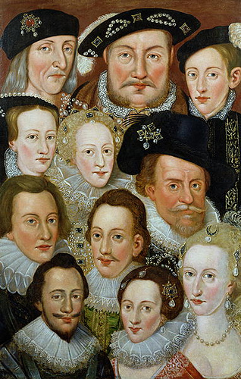
Changing Crimes
Heresy and Treason
Vagabondage
Witchcraft
Smuggling

Slide 13
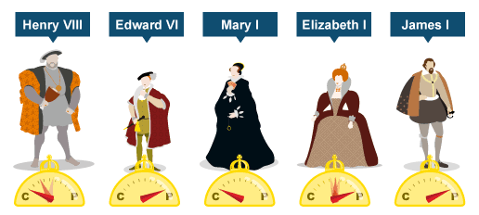
Heresy
  Evidence: John Fox’s, Book of Martyrs, 1563 describes persecutions of Protestants
Heresy
Protestantism is brought to England, and with it, a change of ruler could mean your religious activities were a crime
Monarchs demanded religious singularity
Option to recant and change your beliefs
The Tudor Religious Rollercoaster

Slide 14
Heresy with the Tudors
Henry VIII, 1509-1547
Closed monasteries and seized their land
Oath of Supremacy, 1534: Head of CofE
Edward VI, 1547-1553
Bishops imprisoned in Tower of London
Mary I, 1553-1558
Married Catholic Spanish King Philip II
Restored Catholicism and executed 283 Protestants
Elizabeth I, 1558-1603
Act of Uniformity, 1559: everyone to attend Church
Act of Supremacy, 1559: Elizabeth Head of Church
Elizabeth attempted to achieve a ‘Middle Way’

Slide 15
Treason
Gunpowder Plot
English Catholics were persecuted and not free to worship as they chose so Gunpowder Plotters tried to blow up the King and Parliament in 1605
Conspirators found guilty of treason and sentenced to death
Consequences of the Plot
The ‘King’s book’ shared the plot from James’ POV, included Fawkes confession
  Encouraged anti-Catholic views
Thanksgiving Act, 1605: ordered annual celebration of events + Catholics banned from careers in law or armed forces
Popish Recusants Act, 1606: Catholics to take oath of allegiance to king and forced to attend CofE
Catholics banned from voting until 1829

Slide 16
Vagabondage
Elizabethan criminalization of the poor
1495 Vagabonds and Beggars Act: ‘idle’ people are put in stocks then sent back to their birth village
1547 Vagrancy Act: able-bodied vagabond without work for 3 days was branded and sold into slavery for 2 years – very severe and withdrawn in 3 years
1597 Act for Relief of the Poor: classified people as deserving poor v undeserving poor
1601 Poor Laws: stipulated that Churches must provide aid to the ‘deserving poor’ and punishments were applied to the ‘undeserving poor’
Notes:
When Henry VIII closed the monasteries in 1530’s, there was nowhere for the poor travellers to turn. Vagabonds came to be seen as even more of a problem and the poor and needy became more closely associated with crime.
The criminalization of the poor solidifies the socio-economic divide between classes: you are either wealthy and moral or poor and prone to criminal activity. This belief is fed by the economic problems in the country leading to high unemployment rates and the need to commit petty crimes just to survive.

Slide 17
Witchcraft
Evidence: James I’s Demonologie
There is general belief in witchcraft which is fuelled by religious changes and James I’s interest in witches, attitudes towards women and the uncertainty created by the civil wars
Matthew Hopkins: ‘Witch-finder General’ 1645
In the later 17th century, there was an increasing demand for a more scientific and objective approach to evidence (Age of Enlightenment)
Superstitious attitudes decrease – ‘witches’ seen as confidence tricksters
Notes:
Again, as before, changes in law results in a new crime : witchcraft

Slide 18
Increased Witchcraft Accusations
Religion and witchcraft
James’ Demonologie
Social Upheaval
Matthew Hopkins
Attitudes towards women
Notes:
Religion and witchcraft – Protestants believed the devil would tempt good Christians away from God. Increased talk of the devil increased fear in local communities. Unexplainable events were now explain by witchcraft. This turned religious sects against eachother.
James’ Demonologie –
Social Upheaval
Matthew Hopkins
Attitudes towards women

Slide 19
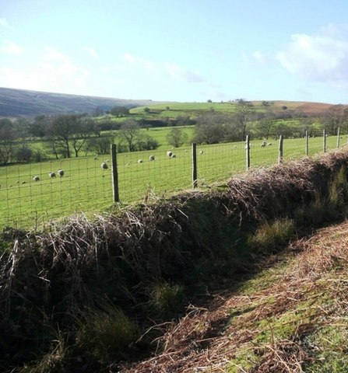
Enclosed Land
Wealthy landowners begin enclosing their land protect their property and profits
The 1671 Game Act made hunting and gathering materials on enclosed land illegal
Opinions about this law was divided along class lines
Consider the differences/similarities between Norman poaching and EME poaching.
Notes:
The Game Act stipulated that non-landowners were not allowed to keep guns, bows, greyhounds, ferets, or snares.
Many poor people continued to hunt to supplement their meager diets. In some ways, the anti-poaching law made the criminal activity worse as poachers would band together and form a gang, often resorting to violence to avoid capture.

Slide 20
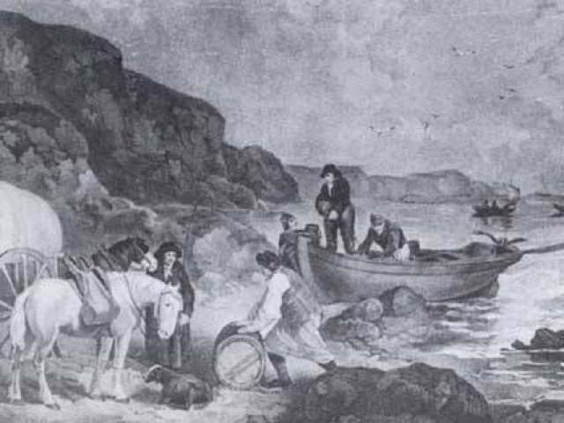
Smuggling
Import duties were first introduced in the 17th century
Taxes applied to
some luxury
items, ie: alcohol
and tea

Slide 21
Factors influencing Crime
Growing Population
Economic Changes
Printing
Religious Changes
Landowners’ Attitudes
Political Changes
Match up the crimes with their factors.
Notes:
Landowners → instigated laws against the poor (ie: vagabondage) and brought tougher laws surrounding crimes against property
Printing → led to increased fear of crimes as it illustrated crimes in a way not experienced before
Population growth and economic changes → together compounded the problem of unemployment and poverty which would lead to more crime in this era
Religious and political changes → explain tougher laws surrounding crimes against royalty and church authority.

Slide 22
Industrial England,
1700-1900

Slide 23
Smuggling
Specific evidence: Hawkhurst Gang
Goods were brought into the country without paying import duties, allowing traders to sell at a cheaper price
Reasons for Increase
Reasons for Decrease
Fear of smugglers
Attraction of smuggling
Organised Gangs
Public Attitudes
Harsher punishments
Improved law enforcement
Government changes
Notes:
Growing on from the import duties on alcohol and tea in the 17th century, in the 18th century there were import duties on cloth, wine and spirits as well. This crime is directly caused by the introduction of import duties and decreases due to the decreased duties
Increase:
Fear of smugglers
Attraction of smuggling – 70% of smugglers were labourers – or these people, on a low-income, smuggling was a quick and easy and exciting way to earn much more money in just one night. With unemployment rates high, it was an easy solution.
Organised Gangs – gangs could be as large as 50-100 members - they were well armed and operated with little fear of the customs officers, who were low numbered and undertrained. The gangs often worked at night were they could go unseen – this helped to avoid capture as well.
Public Attitudes – view as a social crime, the general public and wealthy people alike benefitted from paying lower prices for the same goods. As a social crime, people were unlikely to report the criminal activity. The public disliked the introduction of the duties in the first place, and were rewarded when they helped the smugglers – there was no incentive to report the crime.
Harsher punishments - fell under the bloody code meant the penalty was death
Improved law enforcement – as we move into the period, developments in law enforcement improve, increasing visibility of the law and ability to catch criminals
Government changes – by lower the import duties in 1780’s, William Pill took away the incentive and profit of breaking the law. They were reduced again in the 19th century and the crime all but disappears (until the modern period)

Slide 24
Highway Robbery
Increase in crime:
Road improvements
Movement of people
  And their money
Increased unemployment
Ineffective law enforcement
Decrease in crime:
Improved banking systems
Mounted patrols (Bow Street Runners)
Harsh punishments
Evidence: Dick Turpin and Jack Shepherd
Notes:
Highway robbery saw its rise during the uncertain times of the Civil Wars, but the crime reached a peak in the 1700’s
Highwaymen were often violent and disrupted trade, making them feared by the public and hated by the authorities.
Increase in crime:
Road improvements and Movement of people
Due to the movement of people from the country side to larger towns, there were many lonely and isolated areas outside of towns. The rough road conditions meant that coaches had to slow down to avoid damaging the carriages, which made them easy targets for highwaymen.
When roads improved, there was a higher volume of travellers, however, they also didn’t need to slow down – this can be seen as a factor for both increase and decrease
And their money
More people were travelling in their own coaches with large sums of money due to in adequate banking systems adding to the incentive for highway robbers
Increased unemployment
After the Civil Wars, soldiers demobilized soldiers struggled to find honest ways of earning a living. Becoming a highwayman was a quick solution.
Horses and Handguns became easier and were cheap to purchase – handguns were quicker to load. This provided the highwayman with the tools to be more efficient in their criminal activities.
Ineffective law enforcement: There were no organized police force and local constables did not track criminals across counties.
Highwaymen were supported by locals and could hide and sell their stolen loot in taverns, at least until justices of the peace refused to license taverns that were frequented by Highway man.
Decrease in crime:
Improved banking systems
As the banking systems became more sophisticated over time the number of banks grew meaning fewer travellers carried large amount of money, leading to a decreased incentive for the crime.
Mounted patrols (Bow Street Runners)
Open land around London and other towns was built on as the population expanded. Mounted patrols were set up around London and high rewards encouraged informers to report on the activities of highwayman.
Harsh punishments
Specific evidence: Dick Turpin and Jack Shephard

Slide 25
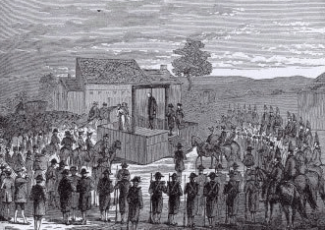
Poaching
The 1723 Black Act makes poaching a capital offense (repealed in 1823 to reduce penalty)
  A response to the Waltham Blacks poaching gang
Only landowners
with land worth
over £100 a year
were allowed to
hunt

Slide 26
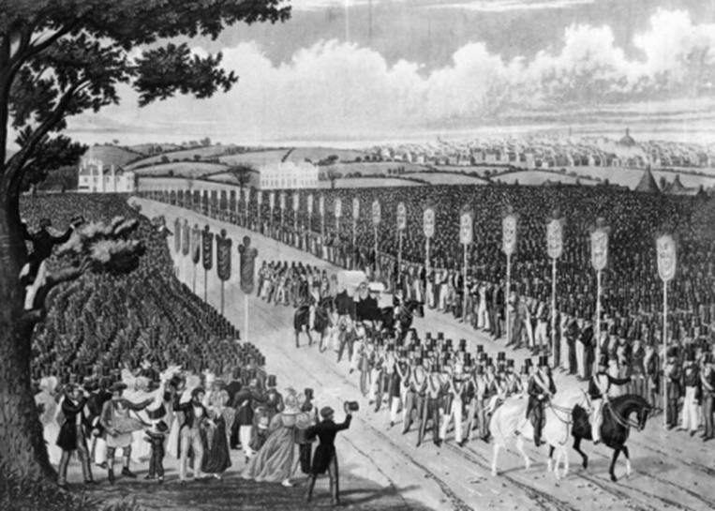
Tolpuddle Martyrs
"My lord, if we had violated any law it was not done intentionally. We were uniting together to save ourselves, our wives and families from starvation." (George Loveless)
Notes:
The government had taken repressive measures to control domestic unrest for some years. The Combination Acts of 1799 and 1800 had been passed by William Pitt’s government, outlawing unlawful ‘combinations of workmen’, and collective bargaining (trade unions) that organised workers to call for better working conditions and increased wages (or just those that were in line with inflation).
The crime of the Tolpuddle Martyrs was “administering an illegal oath” is another example of an activity that was not criminal until law makers made it one. At the heart of this case, the men of Tolpuddle (loveless and company) were arrested and transported because the aristocracy were afraid of a rebellion from the lower class - again, poverty is a crime.
These men met to discuss how to get a higher wage for their labour - an early form of a trade union. Wanting to protect their wealth, the upper class punished these men. This motivation is seen within the crime of poaching, vagabondage and smuggling. In this way, not only is it a crime to be poor, but to also want to do better for yourself. Keep the low down so they can be controlled.
These men, who were sent to Australia through transportation, were pardoned 4 years later, for a crime that wasn’t a crime when they met.
https://www.thegazette.co.uk/all-notices/content/100553
Bow street Runners (Victorians)
Were set appointed in London. As London population increase directly resulted in the increase of crime
Juveniles (Victorians)
Reformers realize putting children in prisons with adults they were more likely to continue a life of crime
Reformatory Schools (Victorians)
Were set up for children under the age of 16. Discipline was harsh and would often include beatings
Population (Victorians)
Crime rates are directly linked to population rates. More people leads to more crimes there will be
Alcohol (Victorians)
Drinking was regarded as the cause of a lot of crime. Pubs were where criinals often met
Poverty (Victorians)
Crime rates increased when there were particular periods of hardship or poverty
City Life (Victorians)
Cities provided plenty of oppotunities for crime to take place, and for criminals to hide
Tithings (Victorians)
Didn't work in this era. As people didn't know each other and there was a lost community feel
Stealing Water (Victorians)
Theft of water was a new crime. Linked to the poor conditions people in cities lived in
Water Companies (Victorians)
Charged high prices for the use of the standpipes in the streets
Company Crimes (Victorians)
Growth of companies in business meant alot a potential for fraud and dishonest financial dealings
Pickpockets (Victorians)
Growth of towns and cities meant more crowds. Which allowed pickpocketing to flourish
Murder and Assault (Victorians)
There was increased fascination with these crimes. Due to popularity of novels e.g Sherlock Holmes
Jack the Ripper
Helped to cause the belief that violent crime was on the rise. However reality was that murder rates were going down
White Slave Trade
Term used in 1830s, referring to female prostitution, and was dangerous for young girls
Double Standards (White Slave Trade)
Heightened sense of high moral standards in this era, however these same people would visit prostitutes
Criminal Law Amendment Act
Anti-slavery legislation. It raised the age of consent from 13 to 16.
Crimes against Authority (Victorians)
Were punished harshly as there was genuine fear from government that a revolution (like the one in France) would happen in England.
Gordon Riots
Anti-Catholic riots. Government had reduced restrictions against Catholics. A mob hated this a began attacking Catholic chapels and houses
Troops (Gordon Riots)
Arrive to arrest the mob, most were a drunken mess after retiring to a pub
Luddites
Machine breaking mob.they wanted to get rid of the new machinery that was causing unemployment among workers
machine breaking
became a crime punishable by death and 17 men were executed the following year
Swing Riots
Land enclosuresforced smallholders from common land into unemployment. Opposition to mechanised practices in agriculture spilled over into violence
Swing Punishment
Swing rioters were awaited trial. Of these, 19 were executed and over 500 transported.
Chartists
Wanted every man over 21 to have the right to vote. They collected thousands of petitions- but many were found to be forged. The movement then collasped
Docklands Strike
Industrial dispute involving dock workers in the Port of London. Resulted in victory as strong trade unions were estabilshed amongst London docks
Reason for Peterloo
Corn laws made staple food prices rise. Alot of people were suffering, including ex-soldiers and sailors lookig for work
St Peter's Field
The place where a meeting adressed by Henry Hunt, aiming for electrol reforms
Local Magistrates (Peterloo)
Attempted to arrest Henry Hunt. But this failed, so Yeomen (soldiers) were sent in to carry out the arrest
Peterloo Massacre
Yeomen (soldiers) Were unable to arrest Hunt, lost control and couldn't keep order. They panicked and many of them drew swords and the crowd panicked
Aftermath (Peterloo)
Meeting left 11 dead and several hundred wounded.
Six Acts
Governments reaction to the Peterloo Massacre, which they hoped would prevent a repeat
Training Prevention (Six Acts)
Any person attending a gathering for the purpose of training liable for arrest.
Seizure of Arms (Six Acts)
Gave power to local magistrates to search any person or property for arms
Seditious Meetings (Six Acts)
Prevented the holding of public meetings of more than 50 people without the consent of a sheriff or magistrate
Misdemeanors Act (Six Acts)
Attempted to reduce the delay in the administration of Justice
Blasphemous Libels Act (Six Acts)
Provided stronger punishments for publications judged to be blasphemous
Newspaper and Stamp Duties (Six Acts)
Radical publications had to pay stamp duty, before they avoided stamp duty because they published opinion not news
Tollgates (rebecca riots)
Were introduced on toll roads in Wales. Englishmen were now appointed to be collectors.
Local Collector (rebecca riots)
Previously before the Englishmen, local collectors would let people go without paying the tollgate fee.
Englishmen (rebecca riots)
The new collectors who put more gates up and kept as much money as possible for himself. Angering farmers
Rebecca Riots
Farmers attacked the turnpikes. And disguised themselves as women.
Aftermath (Rebecca Riots)
A local magistrate ordered the gate that had been destroyed to not be rebuilt and no more new gates to be built.
Cato Street Conspiracy
Failed plot to blow up Prime Minster LORD LIVERPOOL. Whilst he and his government were at dinner
George Edwards
A police spy who was member of the cato conspiracy to spy on them. Shows police PROACTIVENESS.
Arthur Thistlewood
Leader of Cato Street Conspiracy
Cato Conspiracers
After a blow up with police officers. The majority were charged with conspiracy and either executed or transported
Tolpuddle Martyrs
Group of agricultral labourers. Were arrested for swearing a oath as members of the Friendly Society of Argricultural Labourers
Friendly Society (of Agricultural Labourers)
Formed to protest against lowered agricultural wages. As more machines were being used
Tolpuddle Punishment
The six leaders were arrested and sentenced to 7 years in Australia

Slide 27
Factors influencing Crime
Population Changes
Economic Changes
Changing Attitudes in Society
Fear of Rebellion
Match up the crimes with their factors.
Notes:
Population and economic changes → industrial revolution, though created new jobs, there were not enough to go around. In bigger cities, such as London and Liverpool, unemployment rates were high. It would not be uncommon for people to turn up to the factories each morning hoping to be picked for work that day only to be turned away. Life was very much a hand-to-mouth existence and families suffered.
In addition, taxes kept increasing which made people turn to crime to survive and pay them
Although education was on the upswing, and children were expected to be in school, they were also needed for labour to help support their families. Though, this, for the most part, kept them out of trouble.
Poverty was prevalent and lead to a criminal underclass. This is further evidenced in our look at Whitechapel.
Fear of Rebellion→ seeing the lower class rise up and execute many of the aristocracy in the French Revolution, Britain did not want the same to occur here. In an attempt to keep the lower class under their control, examples needed to be made. This is evidenced with the Tolpuddle Martyrs.
Upperclass are also responsible for instigating tougher laws and harsher punishments against the poor (ie: smuggling, poaching on enclosed land)
Changing Attitudes → again, in an attempt to keep the lower class under their thumbs, the upper class will change the laws to fit their needs – ie: Toldpuddle Martyrs, ie: harsher punishments
The Tolpuddle Martyrs also show how public opinion can influence what was regarded as a crime. As with smuggling, changing attitudes were an important factor in determining what should be treated as a serious crime.
Reasons for Industrial Crime
Religion (Industrial Britain)
Played a much smaller part in crimes
Taxes (Industrial Britain)
Kept increasing which made people turn to crime to survive and pay them
Compulsory Education (Industrial Britain)
Meant children were at school and not getting involved in petty crime

Slide 28
Change and Continuity
The Rich get Richer
The Poor get prison
1000-1900
Poverty is still a crime (crimes against property)
Laws continue to be created to benefit the upper class and keep the lower class in control
Changing attitudes of what is considered a criminal activity
Notes:
Change and continuity in crimes from 1000-1900: poverty is a crime (the thought here is that the lower class operate under a different set of morals and are behaviourally criminal or accessories to crime. As far as the upper class and the decision makers of the country are concerned, to live or be born in the lower stratosphere means to be prone to crime. Which, to be fair to them, was often necessary to survive: high unemployment, food shortages leading to inflated food prices, political uncertainty all create living conditions that are subpar at best and its human nature to want to thrive.
Continuity for laws to change to benefit the upper class - greed drives this group to continue to make new laws to protect their wealth and secure their profits. This will also be relevant to the application of strict punishments such as blood code and transportation.

Slide 29
Modern England,
1900-present

Slide 30
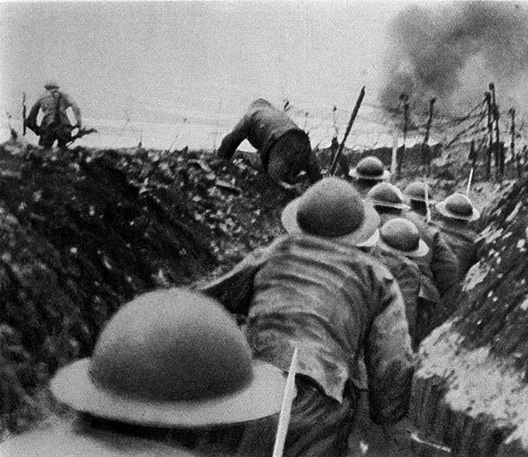

Changing Definitions of Crime
There have been many significant social and economic changes in the 20th century
Notes:
There have been many significant social and economic changes in the 20th century
Social attitudes seem to dominate changing crimes in this period, for example, where homosexuality was once the crime, now homophobic attitudes and behaviours are the crime. This is attributed to the changing sexual attitudes surrounding sexual freedom and expression in the 1970’s.
Similarly, other societal groups are also seeing more protection under the law:
Racial Groups: What constitutes a race crime is made more clear through the 1968 Race Relations Act – jobs, housing and public services are not to be denied to another on racial grounds. In 2006 this law is extended to apply to spreading racial or religious hatred.
Women: With the Suffrage movement came increased rights for women. Where a women was once considered the possession of her partner and law enforcement would not intervene in a violent situation, now there is the Domestic Violence Act, 1976. This law adapts over time to include rape in a marriage (1991) and again in 2014 to include controlling and coercive behaviour.
Social Crimes are still visiable within society but have adapted with the changing times. Smuggling now applies commonly to tax-free cigarettes and alcohol, as well as, drug use and minor driving offenses. As in the past, these are acts that are, in the eyes of the law are a crime, but are generally accepted within society so can often go unreported.
Car Theft
Almost half all thefts involved stealing cars themselves or the items inside them
Traffic Police
A specialist police force to enforce cars are taxed and have insurancee, and driver has a license and driving correctly etc
Computer Crime
Such as hacking is increasing as computers are becoming apart of many's everyday lives
Shoplifting
Huge supermarkets and department stores have made it easier for people to steaal goods unnoticed
CCTV
Has been a breakthrough for police to catch criminals
Trafficking
..immigrants into the country has become a more frequent crime
White Collar Crime
Includes embezzelment,fraud and forgery . These are non violent crimes which are purely for personal gain
Death Penalty
Was abolished in Britain in 1965
Racial Violence
The increased of muticultural races angered many racist whites. Blacks were attacked and clashes between white and blacks gangs
Terrorism
September July 7th attacks, terrorism has been closey associated with Islamic terrorist groups
Police (21st Century)
Well paid; WOMEN officiers are more common.Polices are still specialised
ASBOs
Name tag given to antisocials to name and shame and deter this behaviour
Parole
Prisoners don't serve all their sentance if they behave well, which frees up crowded prisons
Probation
A person has to report to the police and a probation officer
Long Sentances
...and no death penelty meant prisons became overcrowded

Slide 31
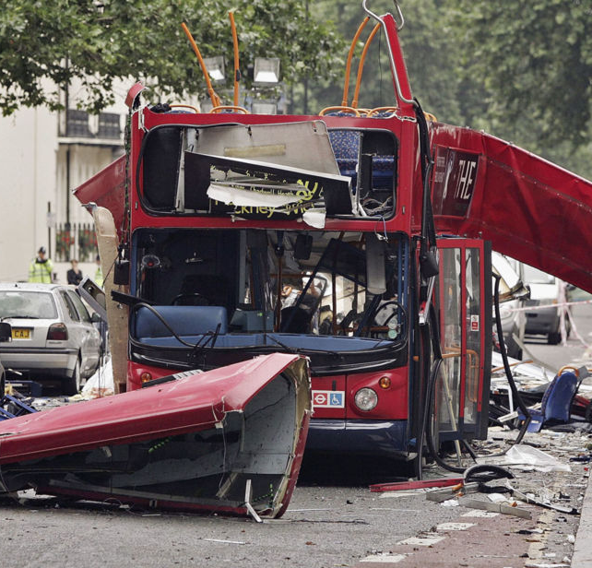
New Opportunities for Old Crimes
Terrorism
Cybercrime
  Fraud
  Copyright theft
  Extortion
Notes:
Terrorism
we’ve seen this before in the Gunpowder Plot, but in the 20th century we see a rise in terrorist organisations in the UK. In the 70’s and 80’s there was the Irish Republican Army. In more recent years, terrorist groups from the Middle East have been held responsible for acts across Europe. Nowadays, these groups communicate their message through the internet.
Cybercrime is categorised as any crime that uses the internet. These crimes are not new, but just carried out in a digital manner. The growing use technologies enables the criminal to commit crimes on much bigger scale, reaching more people/businesses on a global scale.
Fraud – is impersonating another person or business to make money illegally. In the past, it would be done face to face, but now this can be done by electronically tricking someone into providing their bank details.
Copyright theft – examples, such as, illegal downloads of music and movies
Extortion – involves making someone pay money by using threats or blackmail. This would have been done with letters or in person, but now is done with the internet to make their threats on a wider scale.

Slide 32
Factors influencing Crime
Changing Attitudes in Society
Economic Changes
Science and Technology
Reporting of Crimes
Match up the crimes with their factors.
Notes:
Economic changes – economic boom and bust (in 1929). We are seeing less of absolute poverty than before, however, the gap between social classes continues to grow
Yes, crime has increased, however, one must consider the number of criminal reports – with the advancements of law enforcement (training and dealing with more sensitive cases), reporting is on the rise. Report are also more consistent.

